Slide 1
Equine Husbandry

Slide 2
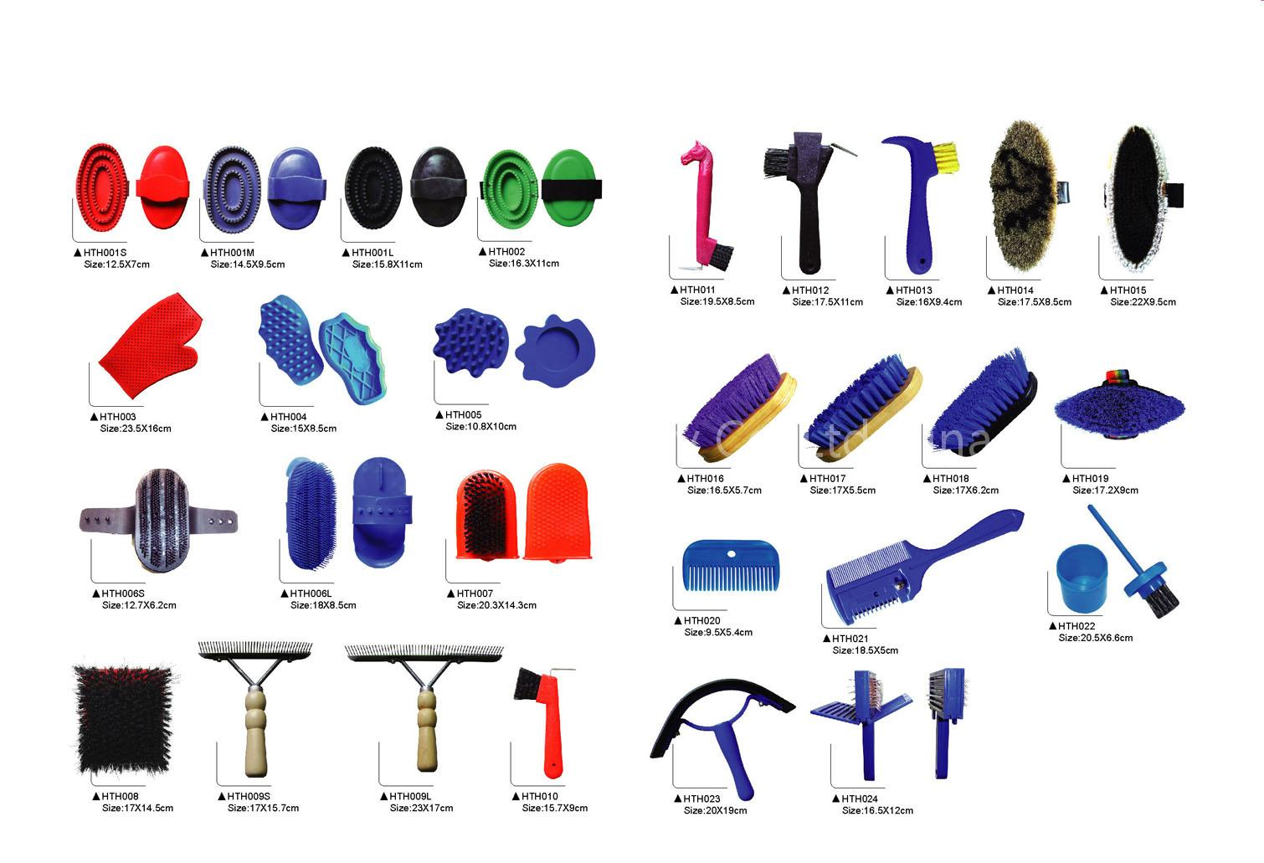
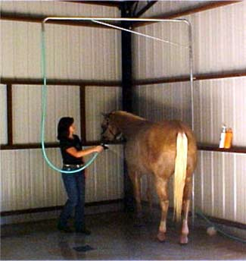
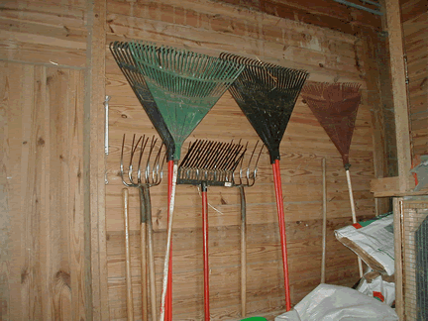
Materials
• Feed and water
• Hoof care supplies
• Bedding
• Bathing and grooming supplies
• Environmental Enrichment Devices

Slide 3
Procedures
A. Observation of animals:
i) Observe all equine species daily for illness, injury, and general condition, including weekends and holidays.
ii) Hoof Care: Observe the animal daily for signs of lameness, long hooves, or other abnormality.
iii) Grooming: Brush and/or bathe the animal to remove excessive dirt and hair as needed.
iii) Teeth Care: Observe the animal daily for abnormalities with mastication, such as dropping feed when eating.

Slide 4
Food and Water
i) Feed animals to meet the current National Research Council recommendations for equine nutrition.
ii) Feed animals housed inside or where they cannot graze at least twice a day. Roughage in the form of hay or other fibrous feedstuff must be provided.
iii) Supplement grain for animals that are not able to meet nutrient requirements on hay and/or pasture alone.
iv) Provide access to selenium/salt supplementation on a daily basis.
  v) Food storage
  (1) Store feed bags on pallets off of the floor and 4-6 inches away from the walls.
  (2) Store bulk feed in leak-proof containers with tightly fitting lids. Label all feed storage containers with milling date.
  (3) Use feed within 6 months of the milling date.
vi) Provide access to clean water at least 2X per day

Slide 5
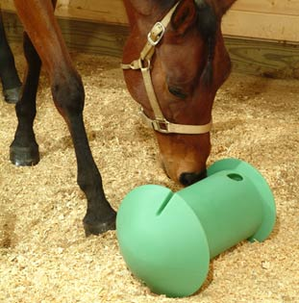
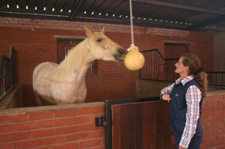
Social and Environmental Enrichment
i) House equines in groups whenever possible.
ii) Maintain visual contact between animals.
iii) Provide enrichment devices, including pasture balls, flavored LIXIT treats, and thoroughly cleaned plastic jugs.
iv) Provide foraging opportunities.

Slide 6
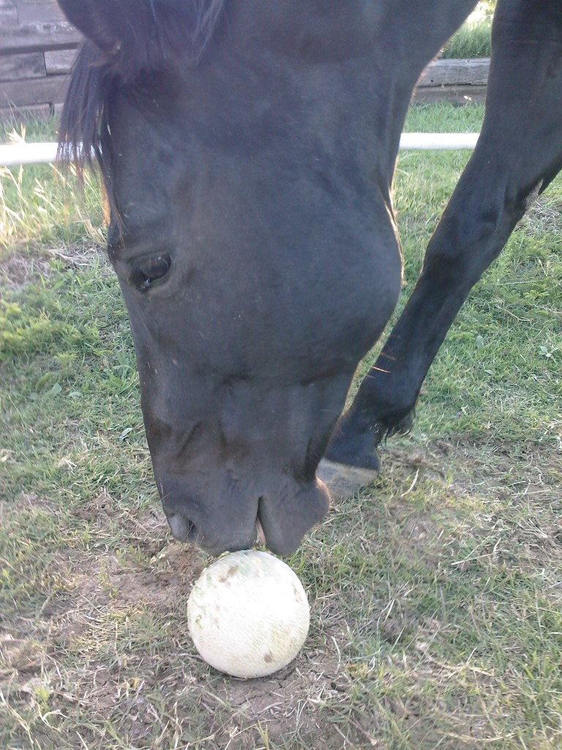
video

Slide 7
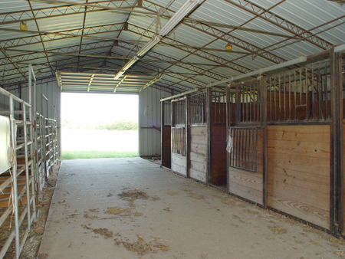
Indoor Requirements
Temperature and Ventilation
  (1) Maintain relative humidity between 50% and 80%.
  (2) Maintain ammonia levels below 10ppm by ensuring adequate ventilation and/or cleaning frequency.
  (3) Maintain ventilation at 25-100 cubic feet/minute/1000 lbs of animal.
  (4) Increase circulation of air and ventilation in hot weather.

Slide 8
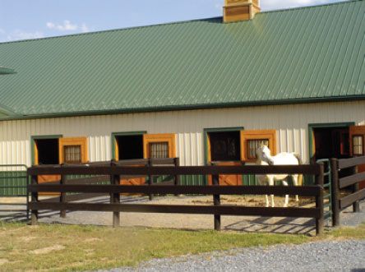
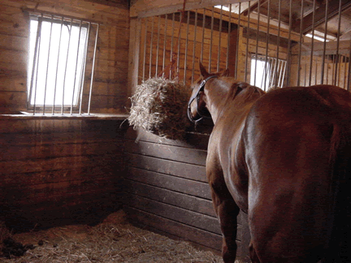
Lighting
(1) Provide 200 lux of light, or one 100 watt bulb per 8m of floor space.
(2) Avoid complete darkness at all times.
(3) Ensure that windows, if present, are at least 5 feet from the ground.
(4) Cover electrical wires and light bulbs with a protective cover.

Slide 9
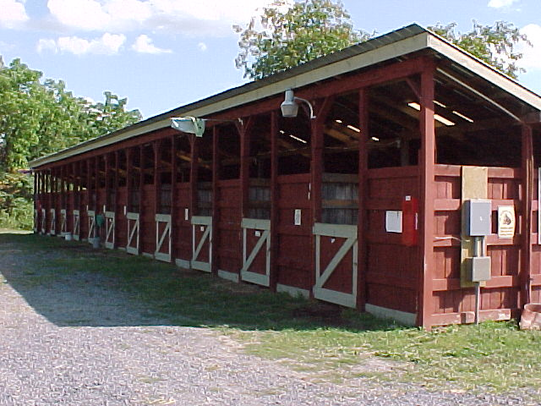
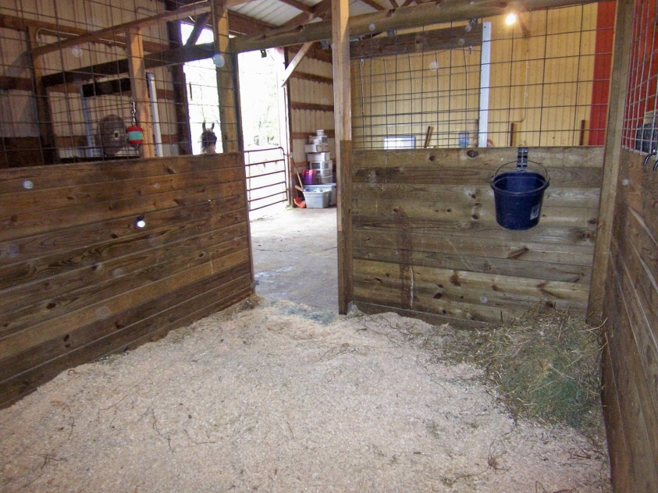
:
Space Requirements
(1) Box Stalls – 9 sq. ft./100 lbs body weight, or 12ft x 12ft
(2) Foaling Stalls: 16ft x 16ft
(3) Tie Stalls – 4 sq. ft./100 lbs. body weight
(4) Alleyways between rows – 8 ft wide
(5) Front of single row of stalls – 4 ft
(6) Ceiling Height – 1 ft higher than the animals ears when the head is at its highest level, or at least 9 feet high.

Slide 10
iv) Bedding
(1) Use straw, wood shavings, peat moss, shredded paper, or sawdust for bedding stalls. Do not use cedar or black walnut wood shavings or cocoa husks due to potential toxicity and can cause laminitis (founder).
(2) Do not use rubber mats alone, except in cases when animal health or experimental design do not permit traditional bedding.
v) Stall Maintenance
(1) Clean stalls daily, or at a minimum of three times per week.
(2) Maintain clean, dry stalls that are free of dust and odor.

Slide 11
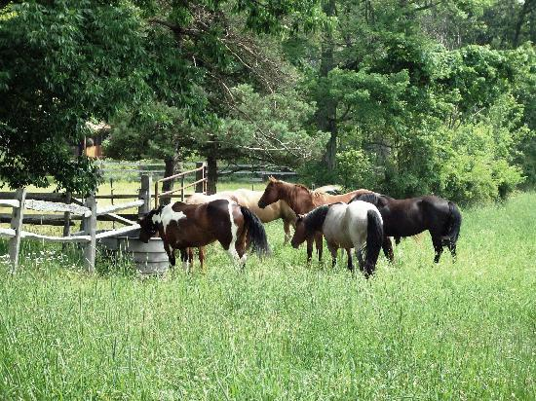
i) Corral: 12ft x 12ft per animal. Larger areas are recommended.
ii) Pasture: 1 acre/horse.
iii) Shelters: minimum of 8 square feet per 100lbs of animals.
iv) Do not continuously house animals in the minimum space required since this does not allow for sufficient exercise.
v) Fencing height:
(1) Horses: minimum of 4.5-6 feet
(2) Ponies: 3.5-5 feet

Slide 12
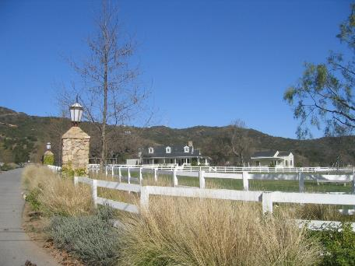
Common Types of Fencing
Wood Rail
Pros
Cons
Attractive
Relatively inexpensive
Requires constant maintenance
Horses can run through fencing if spooked
Nails can be a hazard if they come loose
Not highly visible unless painted- if painted needs to have upkeep
Some use hot wire on the top rail to discourage pushing

Slide 13
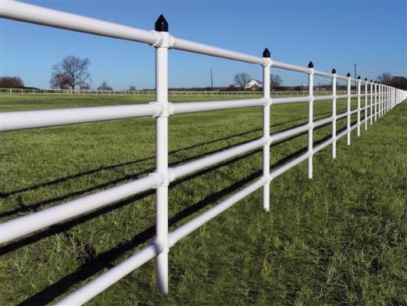
Pipe fencing
Pros
Cons
Attractive
Highly visible
Little maintenance, and lasts a long time
Solid- little give
Expensive to install

Slide 14
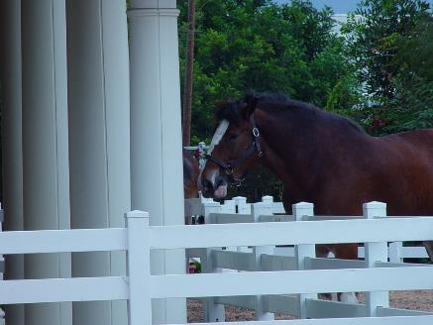
Vinyl or PVC
Pros
Cons
Very attractive
Highly visible
Variety of colors
Low maintenance
No painting
Horses don’t chew
Expensive
Rails can “pop” out if pushed on
Use of hot wire may be necessary

Slide 15
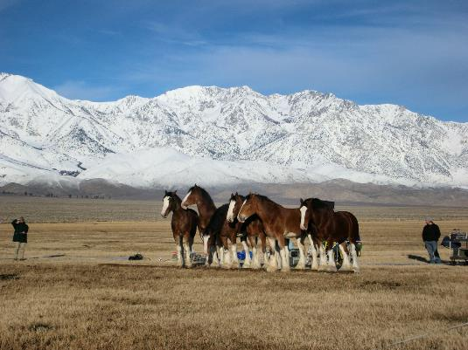
Electric Tape or Hot Wire Fence
Pros
Cons
Should only be used as temporary fencing
Not very visible- needs flags
Needs to be checked regularly
Cheap
Useful in blocking off sections of pasture for rotation
Best in conjunction with other fencing

Slide 16
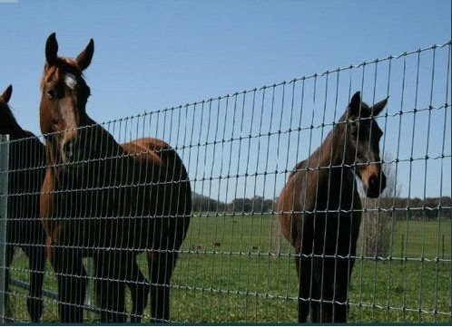
Wire Mesh or Woven Field Fencing
Pros
Cons
Inexpensive
Care in selecting size opening
Not very visible- needs flagging, or a top rail
Vines grow in fencing

Slide 17
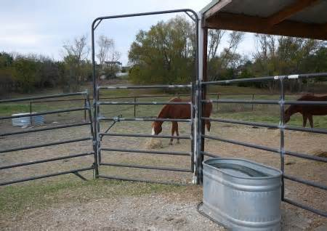
Tubular Panels
Pros
Cons
Easy to install
Portable- can change often
Isolation of horses
Relatively inexpensive
Opening are standard, not made for all size horses, ex. foals

Slide 18
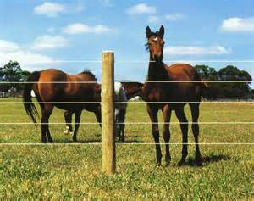
Braided Wire Cable
Durable
Low maintenance
Highly visible
Horses rub
Stretches, so maintenance to tighten it may be necessary

Slide 19
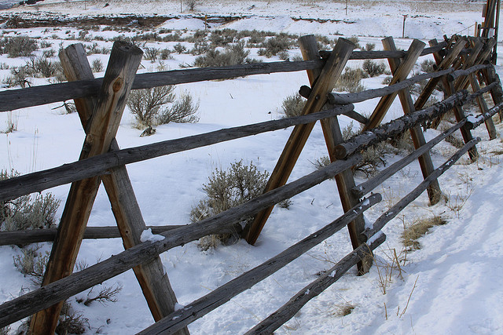
Buck and rail
No digging

Slide 20
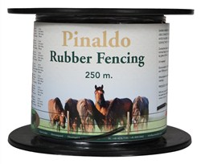
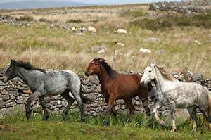
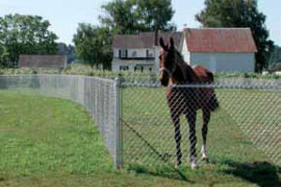
Others

Slide 21
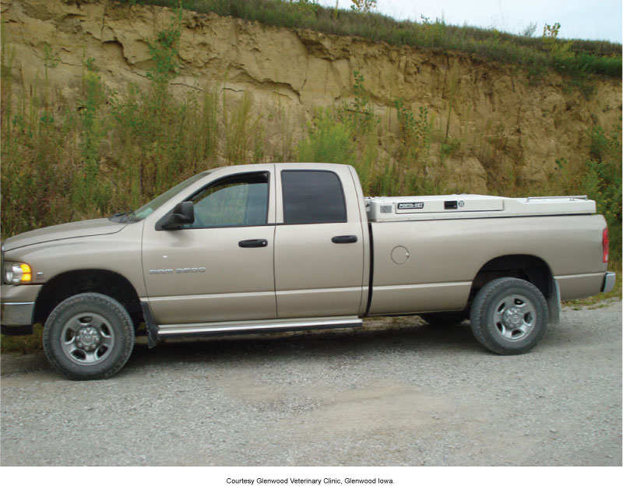
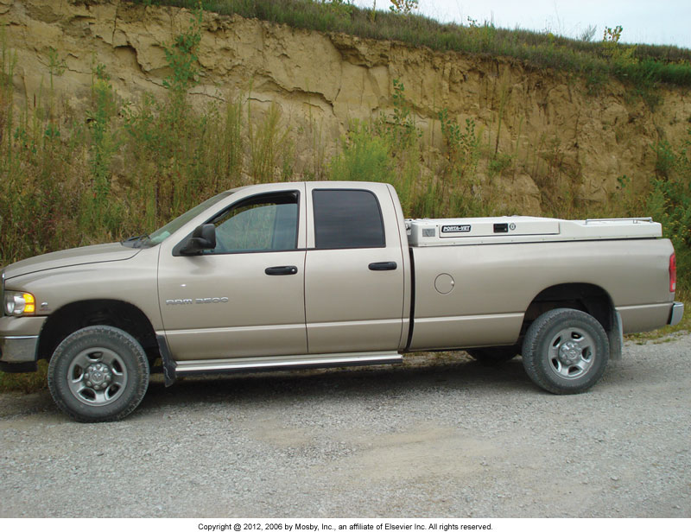
Hospital and Cleanliness
Ambulatory/field service/farm calls
  Vehicle stocked and cleaned like a practice

Slide 22
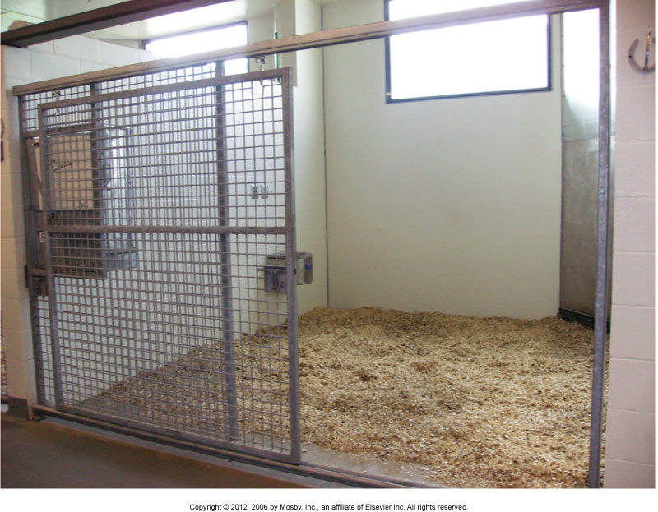
Stall/Hospital Maintenance and Care
Picking
Stripping
Walls
Ceilings
Cobwebs
Aisles

Slide 23

Stall Flooring
Cement
Rubber matting
Dirt-packed clay
Sand
Wood

Slide 24
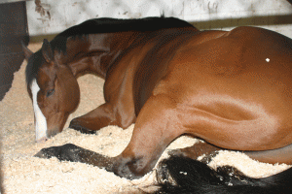
Stall Bedding
Wood shavings
  Not pine or black walnut
Grain straw
Saw dust
Peat moss
Shredded paper

Slide 25
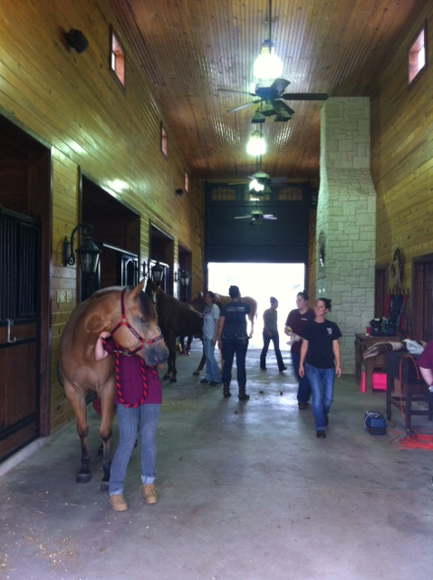
Stall and Stable Ventilation
Dust
Ammonia

Slide 26
Daily Patient Care
Feeding patients
Watering patients
Grooming

Slide 27
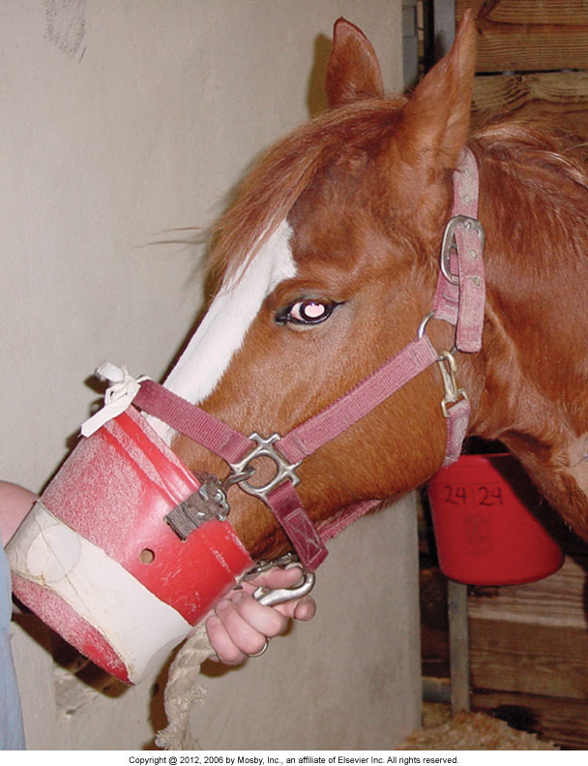
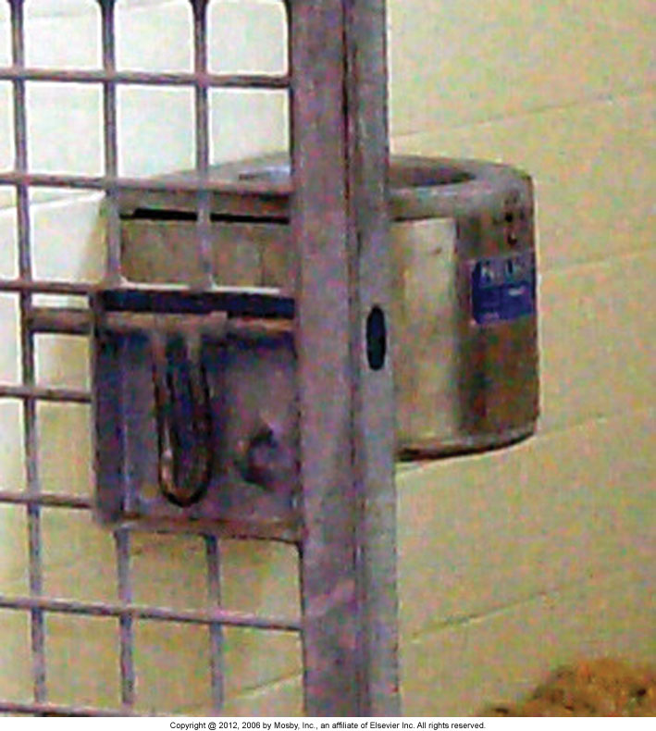
Daily Patient Care (cont’d)

Slide 28
Isolation of Contagious Cases
Isolation
Clearly marked
Hot zones
Employee cleanliness
Skin scald with diarrhea
Cleaning

Slide 29
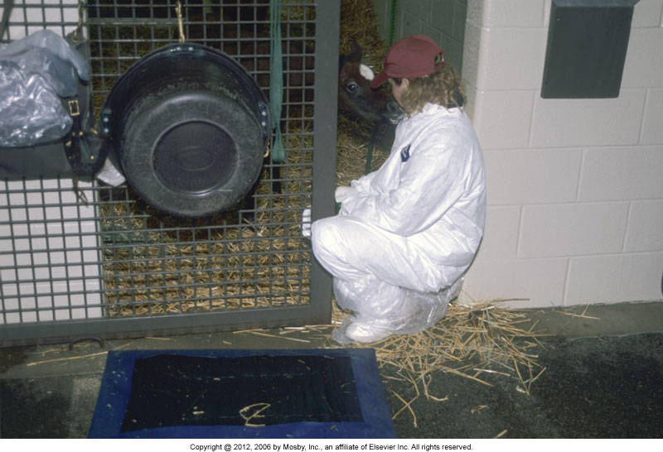
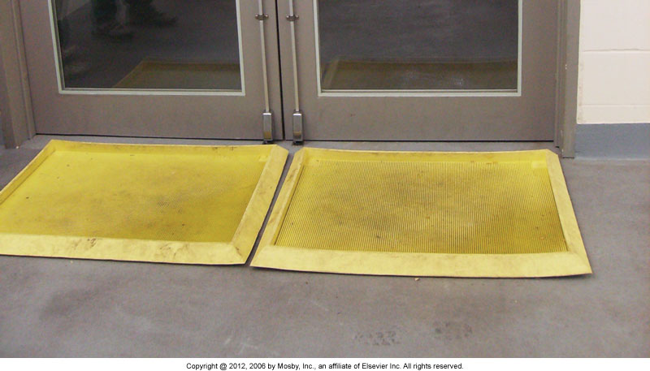
Isolation of Contagious Cases (cont’d)

Slide 30
Recumbent Cases
Can get
  Decubital ulcers
  Compartment syndrome
  Eye trauma
  Limb trauma
  Respiratory disease
  Bladder dysfunction
  Gastrointestinal dysfunction

Slide 31
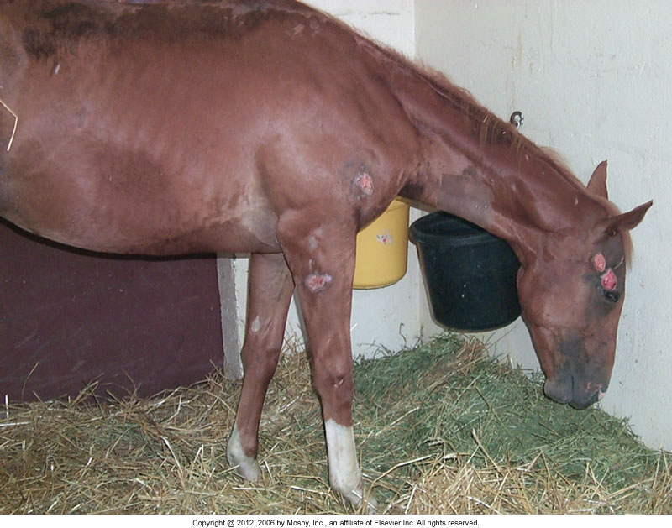
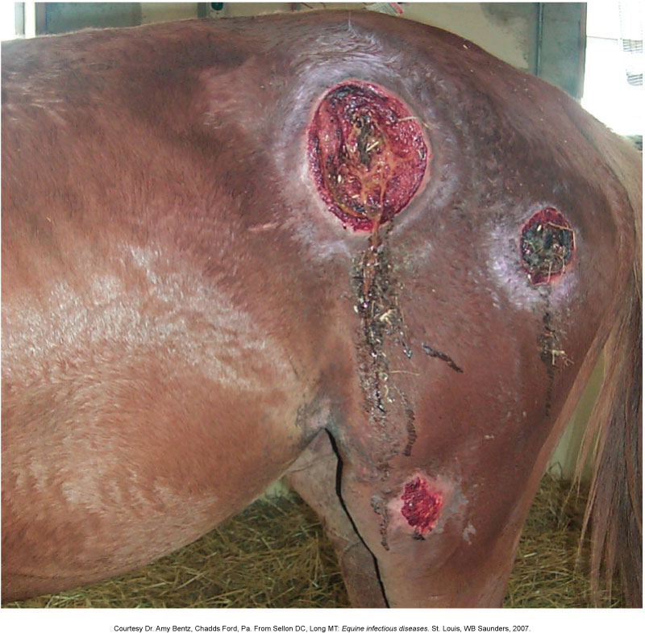
Recumbent Cases (cont'd)

Slide 32
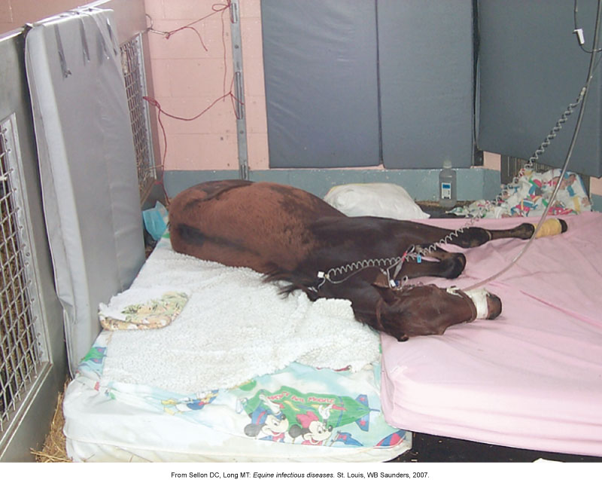

Slide 33
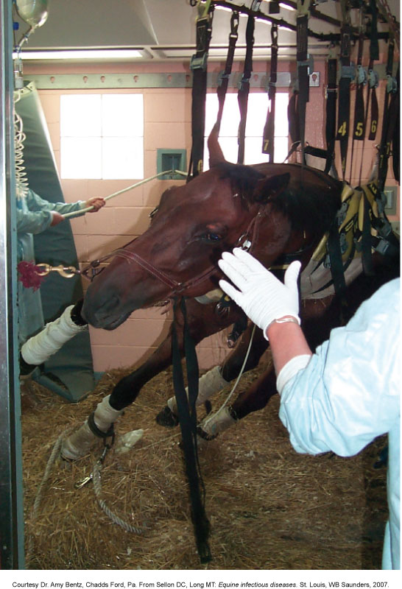
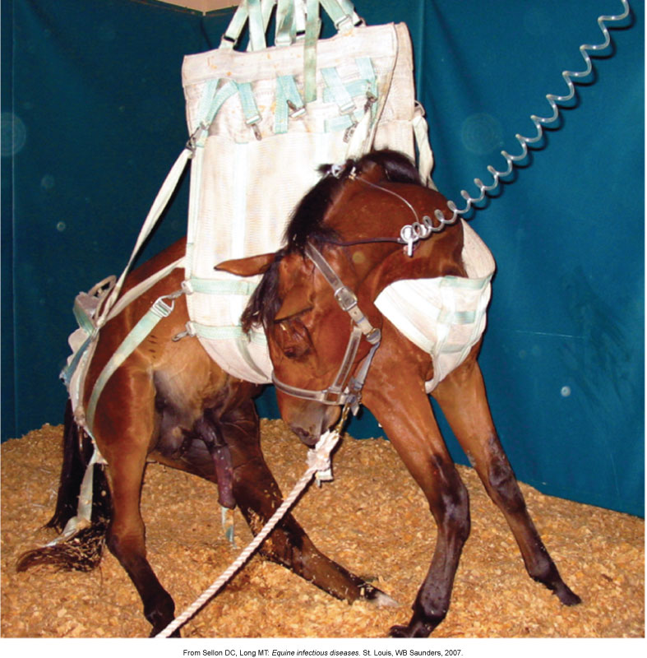

Slide 34
Disinfection after Patient Dismissal
Cleaning
  Bleach
Equipment
Stalls
Disposal of nonreusable items

Slide 35
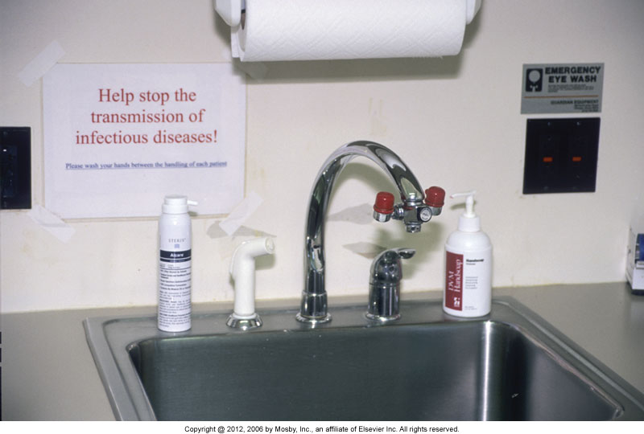
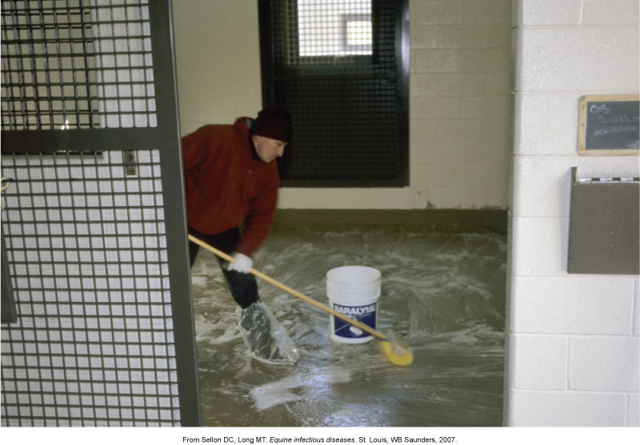
Disinfection after Patient Dismissal (cont'd)

Slide 36
Toxic Plants
Pokeweed- “pigeon berry” “inkberry”
Found in the east and Midwest
Berries are minimally toxic- fleshy root very toxic
Not very palatable put horses will eat
Contains saponins, alkaloids, and histamines
Signs: salivation, coughing, weakness, bloody diarrhea, colic within hours
Respiratory failure, anemia, gastric ulcers in more severe cases

Slide 37
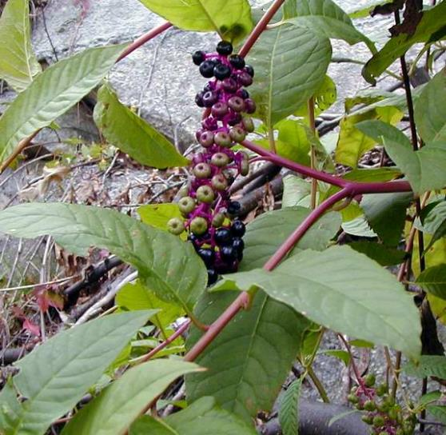
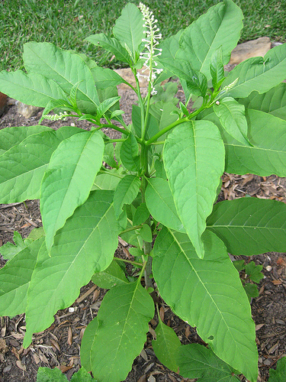
Pokeweed

Slide 38
Jimsonweed
“datura”, “thornapple”, “jamestownweed”
Matures in summer
Nightshade family
All parts are toxic, especially leaves and seeds
Found throughout the US
Contains stramonium, and several alkaloids
Potent narcotic poison- hallucinogen
Interferes with digestion and nervous system
Symptoms- excitement, then sudden depression, colic, diarrhea, thirst, convulsions, coma, respiratory failure, death

Slide 39
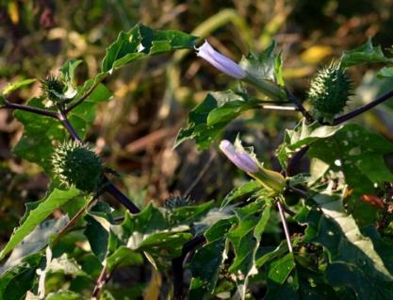
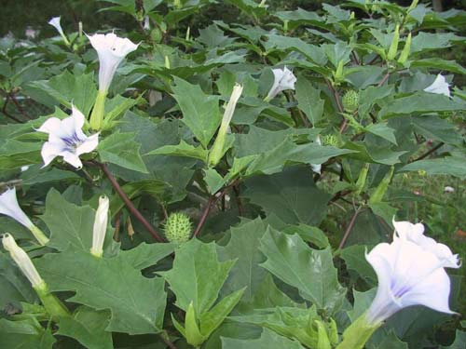
Jimsonweed

Slide 40
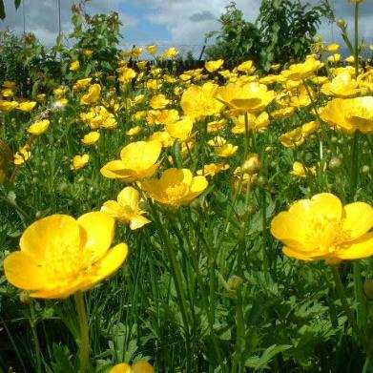
Buttercup
Aka “crowfoot”
Found throughout the US
Contains ranunculin, which converts to irritant protoanemonin when chewed
Causes blistering on skin or lips, salivation, depression or nervousness, blindness, colic, bloody diarrhea

Slide 41
Milkeweed
Many species throughout US
Most potent in West
Often baled with hay- also toxic in dried form
Symptoms- bloating, staggers, rapid pulse, heart problems, depression, weakness, labored breathing, seizures
Contains cardenolides, which interfere with cardiac function, and irritant resins

Slide 42
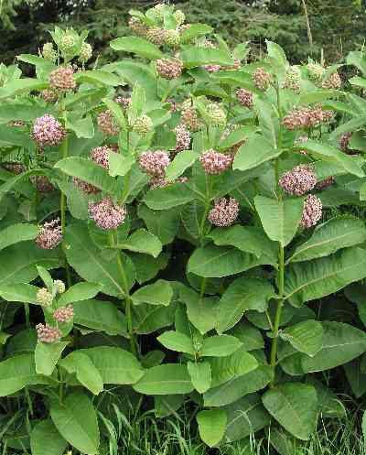
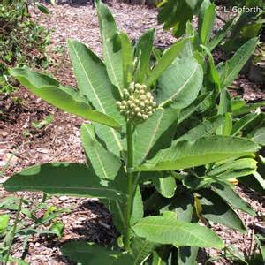
Milkweed

Slide 43
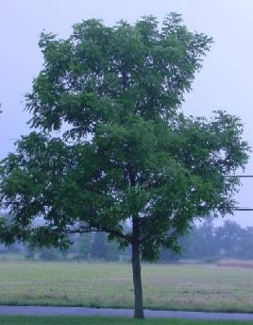
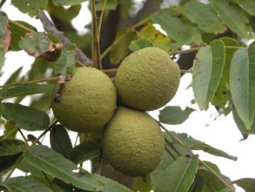
Black walnut
Eastern US and midwest
Horses affected by sawdust or shavings
Contact or ingestion can cause laminitis, colic, respiratory difficulties, depression, swelling in legs
Causative agent unknown, once thought to be juglans nigra (growth inhibitor)

Slide 44
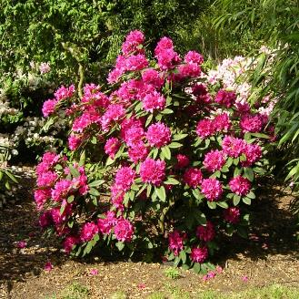
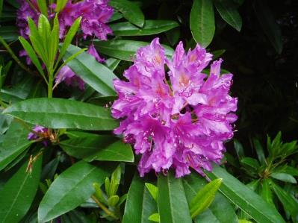
Rhododendron
Wild or ornamental
Found in the northeast, Rocky Mountain states
Toxin inhibits cardiac function, and produces liver and kidney damage
Symptoms- bloating, repeated swallowing, salivation, depression, colic, weakness, colic

Slide 45

Bracken fern
Found throughout US
Poisoning in horses is due to thiaminase, which destroys thiamin (B1), causing vitamin deficiency -- causes myelin degeneration of peripheral nerves
Toxic dried and fresh
Ataxia, depression, abnormal
heart rate, weight loss

Slide 46


Oleander
Seen in East coast, California and Texas
Toxin is oleandrin and neriin- which disrupt beating of heart
All parts are toxic
symptoms- colic, difficulty breathing, tremors, recumbency, and irregular heart rate. Slowed or accelerated pulse.

Slide 47
Others
Hemlock
Locoweed
Tansy ragwot
Red maple tree
Yew
Yellow star thistle
And more…..

