Slide 1
Parasite OvA equine
M. BRANTLEY, LVT

Slide 2
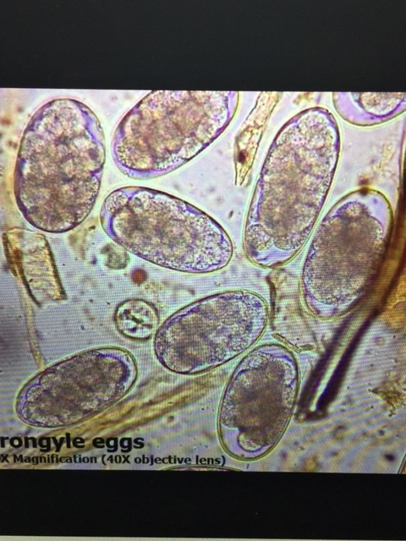
Strongylus vulgarius/edentatus/equinus
Large Strongyles-Bloodworms or redworms
Most dangerous because parasite causes thromboembolic colic and various degrees of anemia.
Larvae live in the artery supplying blood to the intestines. Blood clots form blocking blood flow to intestines
Infective 3rd stage larvae (eggs in soil hatch and eaten w/grass)

Slide 3
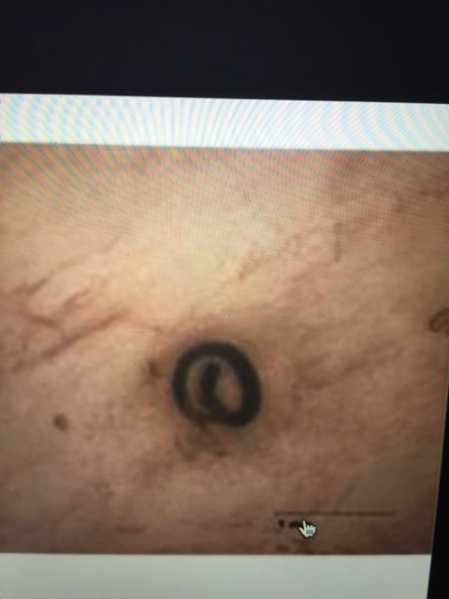
Cyathostominae-Small Strongyle
This parasite is of the highest concern
Larve live in wall of the large intestine therefor not as pathogenic as large strongyle BUT Cyathosomes are of the hightest concern because they are not effected by deworming medications-encysted stage.
4-6 weeks life cycle
Causes Enteritis –diarrhea/GI upset

Slide 4
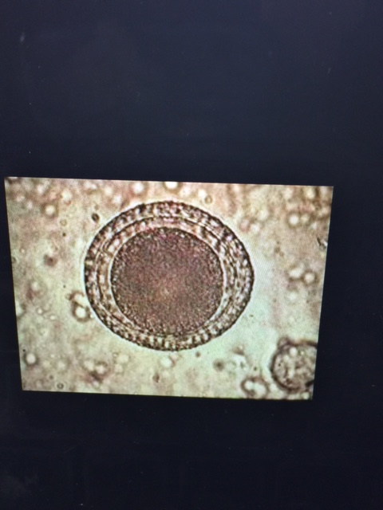
Parascaris equorum
Ascarids-Roundworms
Most common in foals
Infective 2nd stage larve
Larve migrate to lungs sometimes causing pneumonia
Burrow into wall of small intestine and carried to liver via the portal vein
Mature adult roundworms in 3 months
Buildup in large numbers in the anterior part of the small intestine-blocking the small intestine, even rupture
Causes constipation and colic symptoms
Can grow 12 inches in 4 weeks

Slide 5
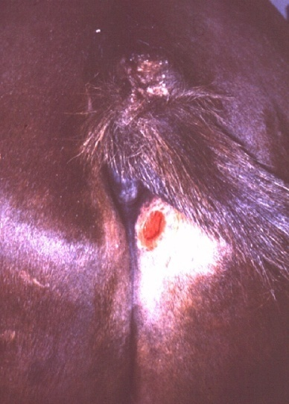
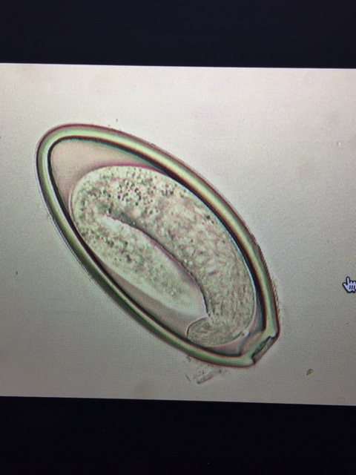
Oxyuris equi
Pinworm”itchybutt”
Diagnose by Cellophane tape placed across anus and then placed on slide and examined under microscope
Bare patches around tail and perineum-Pruritus ani
Thoroughly clean stalls & buckets

Slide 6
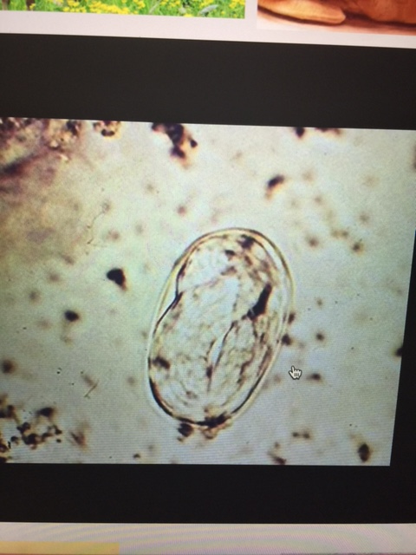
STRONGYLOIDES WESTERI
INTESTIONAL THREADWORMS
ZOONOTIC-CUTANEOUS LARVAL MIGRANS
INFECTS YOUNG FOALS BUT IMMUNITY IS QUICKLY DEVELOPED
VISIBLE MOVEMENT IN OVA UNDER MICROSCOPE

Slide 7
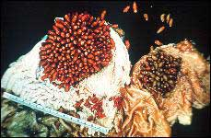
Gastrophilus ssp
Stomach bots
Adult is the bot fly- larve live in horses stomach
G. nasalis, G. hemorrhoidalis, G. intestinalis
L2 in stomach, L4 passed to digestive system and passed to become outside fly
Attach to lining of stomach where they stay for 11 months
Contribute to gastric ulcers and rupture of stomach
Ingested by nits that are attached
to hair

Slide 8
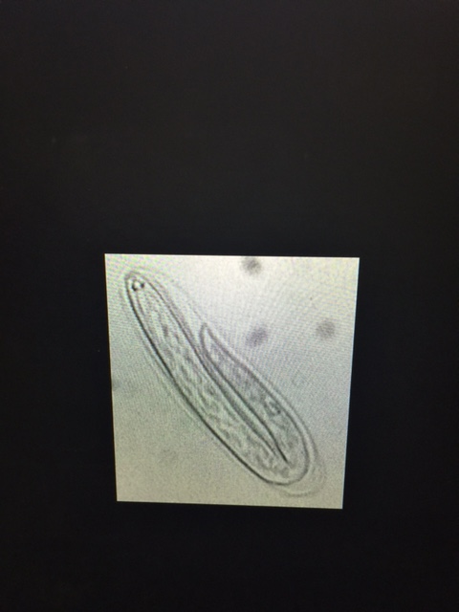
Habronema muscae stomach worms
Cause summer sores-ulcerated lesions, reddish yellow lesions-itchy
Clean lesions with chlorahexidine
6-25mm in size

Slide 9
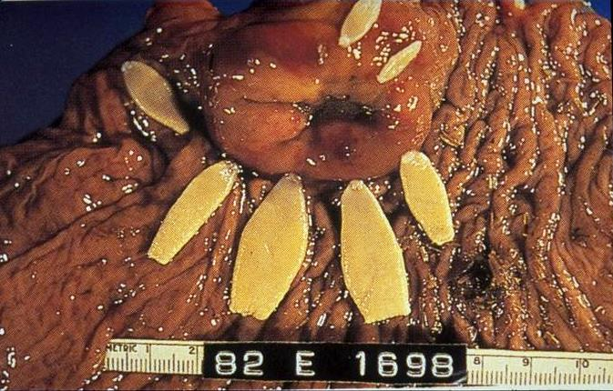
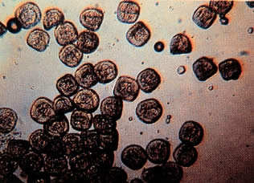
Anaplocephala magna,perfoliata & Paranoplocephala mamillana
Tape worms
Live in the Ileocecal valve-sphincter
Disrupting motility
Difficult to detect on fecal exams
Causes intussusception of the ileum into the cecum

Slide 10
INTERNAL PARASITES
THE AMOUNT OF CLINICAL DISEASE A HORSE WILL SHOW DEPENDS ON THREE FACTORS:
1. Type of parasite involved
2. Number of parasites involved
3. Host Defenses. Young and debilitated animals more susceptible

Slide 11
Assignment:
RESEARCH THE BAERMANN APPARATUS. INCLUDE SPECIFIC INFORMATION:
SUPPLIES NEEDED TO PERFORM TEST.
HOW IT WORKS.
USED TO DIAGNOSE WHAT?
DUE: AT THE END OF CLASS

