Slide 1
Equine Pathology

Slide 2
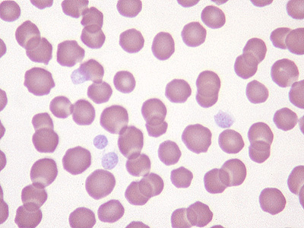
Normal equine RBC
Equine erythrocytes are about the same size as feline erythrocytes and, similarly, lack central pallor
Blood from healthy horses often displays prominent rouleaux formation. Occasional Howell-jolly bodies are observed in blood smears from healthy horses
The erythrocyte lifespan in horses varies from 140-150 days.

Slide 3
Clinical Chemistry Normal Values for Horses
ALB 2.5 - 4.2 g/dL
ALKP 109 - 315 U/L
ALT 3 - 25 U/L
AMYL < 30 U/L
AST 205 - 555 U/L
BUN 8 -27 mg/dL
Ca 10.7 - 13.4 mg/dL
Ionized Ca 50 - 60 % of total Ca
CHOL 51 - 109 mg/dL
Ck 90 565 U / L
Cl 94 - 102 mmol/L
CO₂ 24 - 31 mmol/L
CREA 0.6 -1.8 mg/dL
GGT 12 - 45 U/L
GLU 72 -114 mg/dL
K 2.7 - 4.9 mmol/L
LDH 520 - 1480 U/L
LIPA 460 - 870 U/L
Mg 1.6 - 2.5 mg/dL Na 132 -141 mmol/L
PHOS 1.9 - 5.4 mg/dL
TBIL 0.1 - 1.9 mg/dL
TP 4.6 - 6.9 g/dL
TRIG 11 - 59 mg/dL
URIC < 0.5 mg/dL

Slide 4
Hematology Normal Values for Horses
WBC 5,500- 12,500 /cubic mm
Platelets 100,000-600,000 /cubic mm
Segmented Neutrophil 2700 - 6700/cubic mm or 30 - 65%
RBC 6,500,000-12,500,000 /cubic mm
Bands 0-100 /cubic mm or 0-2%
MCV 34-58 fl
Lymphocyte 1500-5500 / cubic mm or 25-70%
Hemoglobin 11 -19 g/dL
Monocyte 0 - 800 /cubic mm or 0.5 -7%
PCV 32 - 52 %
Eosinophil 0- 925 / cubic mm or 0 -11%
ACL Fibrinogen 150 - 375 mg/ dL
Basophil 0-170 / cubic mm or 0-3%
Fibrinogen (Miller) 200 - 450 mg/dL

