Slide 1
Caslick (Pneumovagina Repair)
Reasons
  Prevents involuntary aspiration of air into the vagina.
Causes
  Poor conformation
  Injury, breeding, foaling

Slide 2
Caslick (Pneumovagina Repair) (cont’d)
  Horses that need Caslick
    Old thin mares with sunken anuses
    Racing mares that aspirate air
    Breeding mares
    Mares foaling
  AX
    Tranquilize
    Local ax: Vulva region

Slide 3
Caslick (Pneumovagina Repair) (cont’d)
Preparation
  Remove feces from rectum
  Tail bandage (keep out of the way)
  Scrub region and rinse thoroughly
  Use nonirritating scrub and 4 × 4 gauze

Slide 4
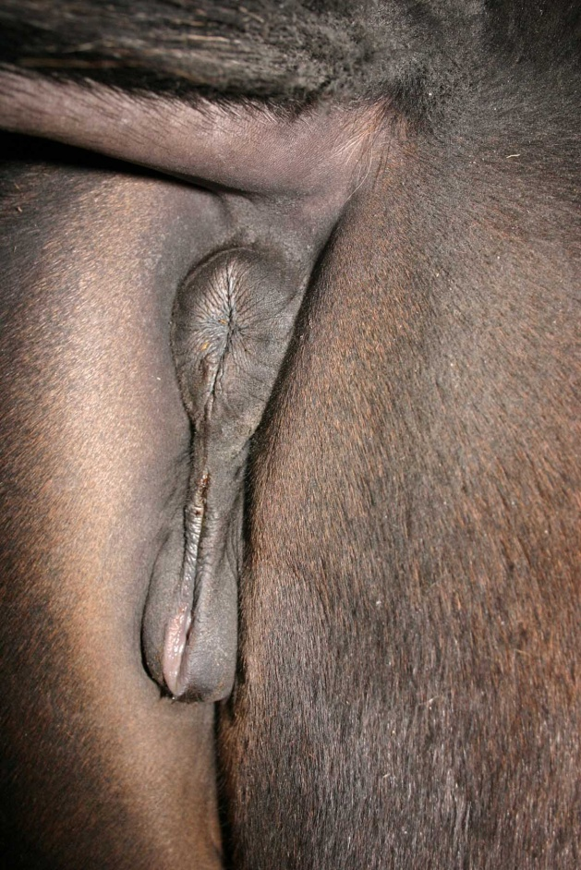
Caslick (Pneumovagina Repair) (cont’d)
Procedure
  Remove a ribbon of mucosa tissue about 3 mm wide from each edge of the vulva labium (lips of vulva); done with tissue scissors.
  Cut halfway down or as much as two thirds the length of the vulva.
  Close raw edges together using a simple interrupted pattern.
  Use nonabsorbable or absorbable sutures.

Slide 5
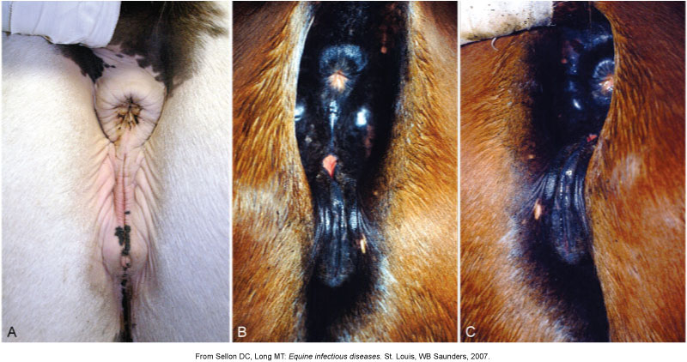

Slide 6
Caslick (Pneumovagina Repair) (cont’d)
Postoperative care
  Remove sutures in 7 to 10 days.
  Leave area alone until healed.
  Check periodically to make sure sutures or skin is intact.
Complications
  Sutures may tear out.
  Too much tissue can be removed (hard to close); must be opened before parturition or breeding.

Slide 7
General Anesthesia
Risks
  Prone to ventilation problems
  Compartment syndrome. Page 276

Slide 8
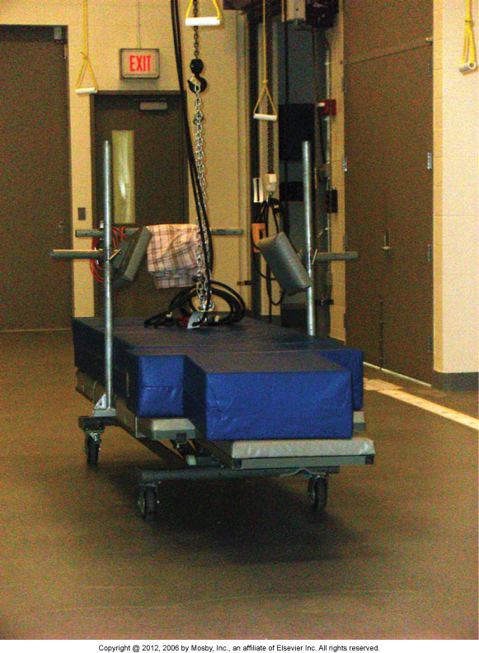

Slide 9
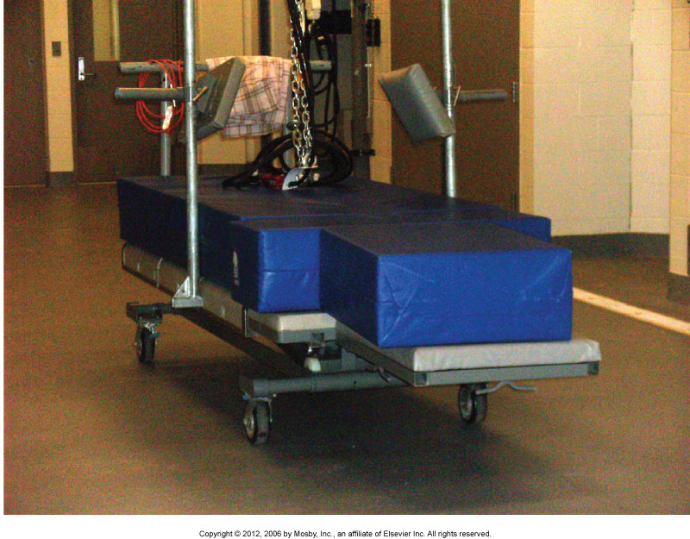

Slide 10
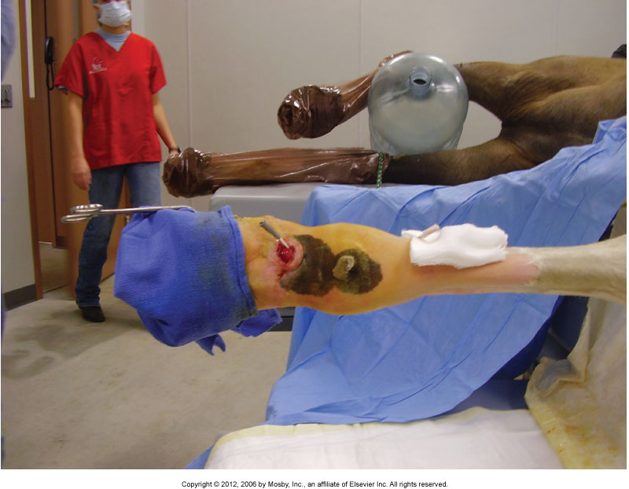

Slide 11
General Anesthesia
Induction
  Commonly use injectable drugs, as well as for maintenance
  Injectable drugs and maintenance with gas anesthesia
  Induction with gas anesthesia and maintenance with gas anesthesia (Isoflurane) foals

Slide 12
General Anesthesia (cont’d)
Intubation
  Orotracheal
  Nasotracheal
  Direct tracheal intubation
  Tracheotomy

Slide 13
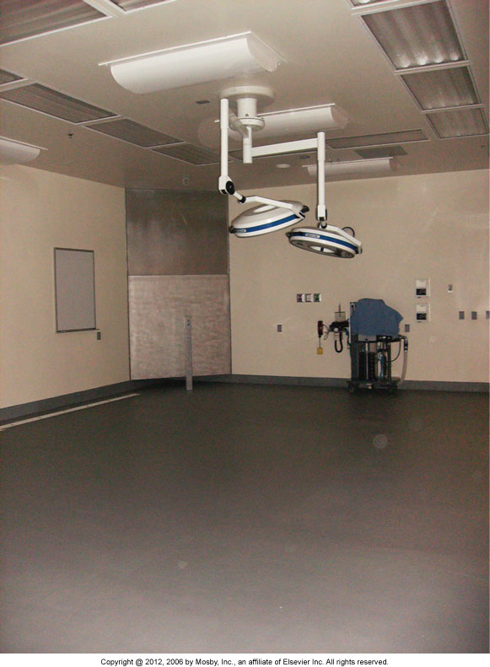
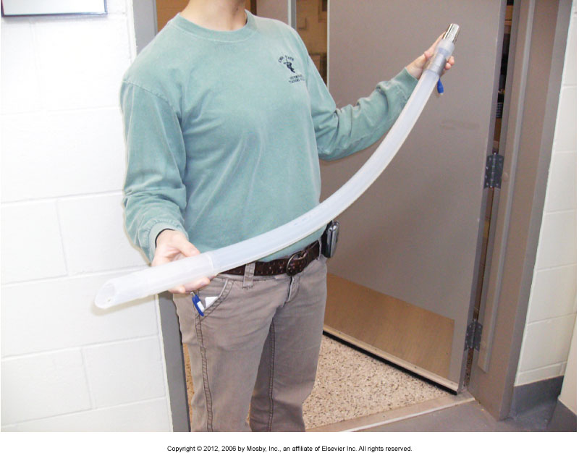
General Anesthesia (cont’d)

Slide 14
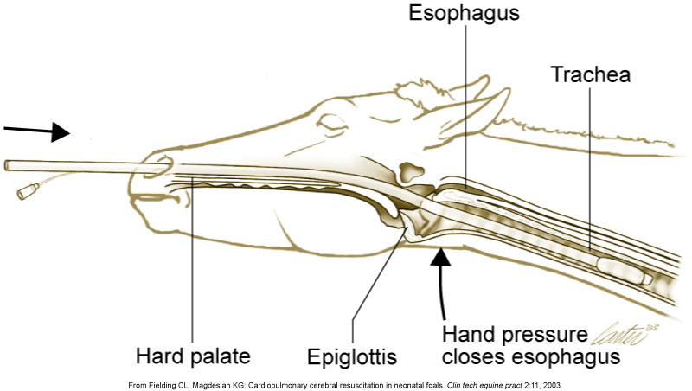

Slide 15
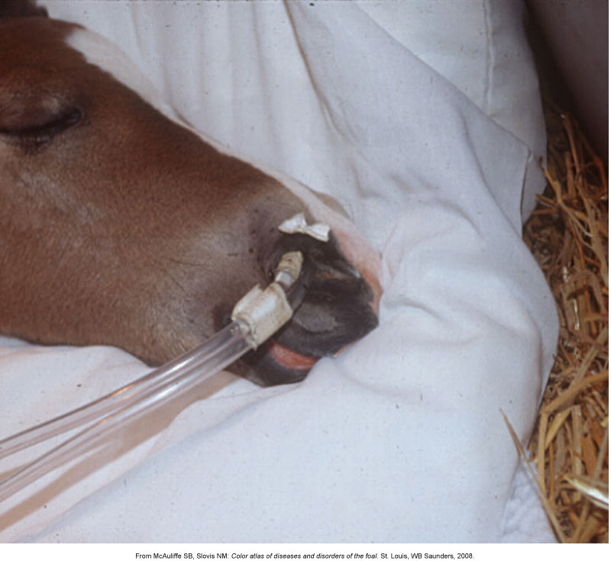

Slide 16
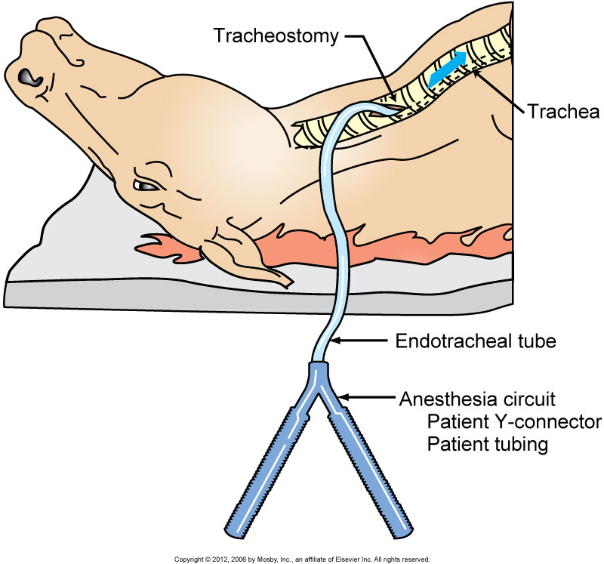

Slide 17
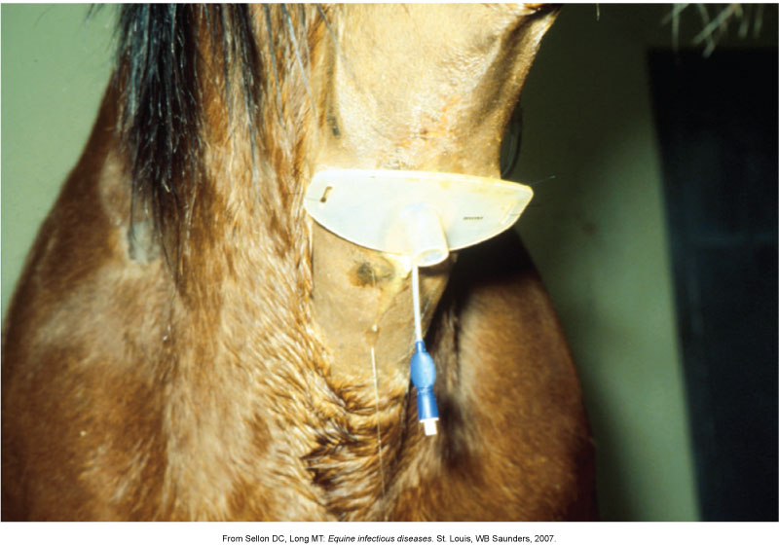

Slide 18
General Anesthesia (cont’d)
What to monitor
  Temperature
  Pulse rate and rhythm
  Respiratory rate and depth
  Capillary refill time
  Mucous membrane color
  ECG
  Blood pressure
  Oxygenation/ventilation
  Depth of anesthesia

Slide 19
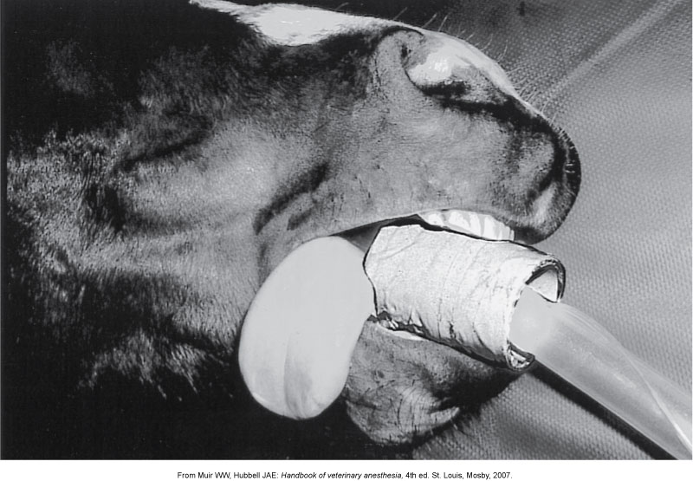
General Anesthesia (speculum)

Slide 20
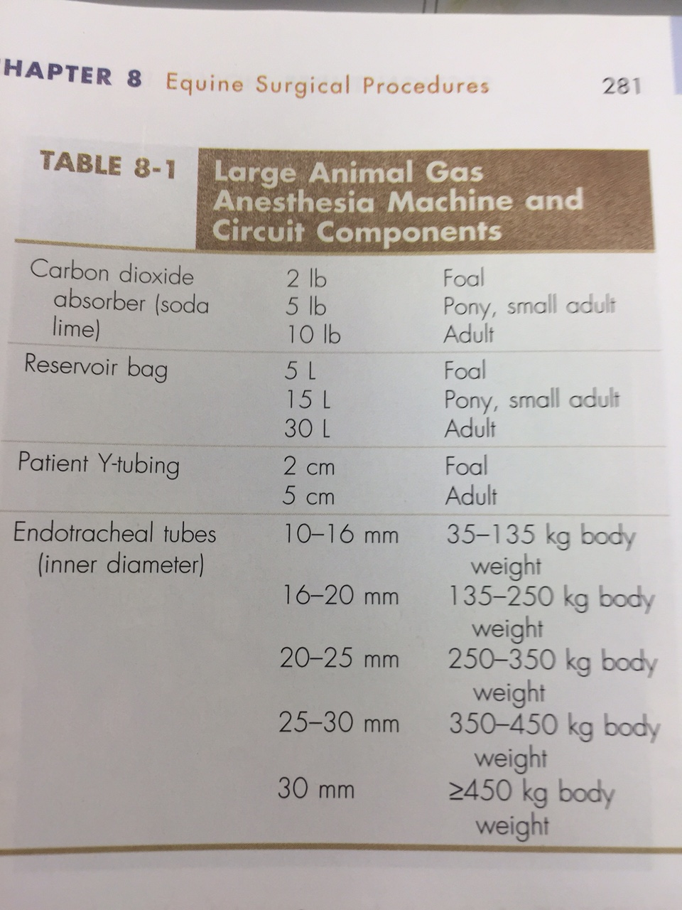
General Anesthesia (size of tube p#281)

Slide 21
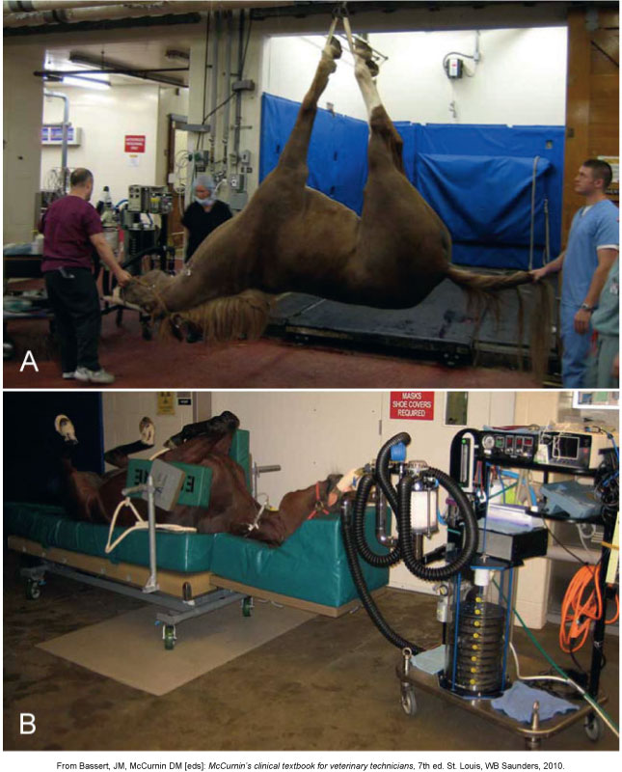

Slide 22
General Anesthesia (cont’d)
Rolling the patient
  The down lung often partially collapses
  Roll slowly
Control of bleeding
  Tourniquet
  Esmarch bandage

Slide 23
General Anesthesia (cont’d)
Recovery
  Lateral recumbency
  Do not encourage the patient to try to stand before the drugs have had sufficient time to wear off
  Avoid external stimuli
  Do not allow to eat or drink immediately
    Provide water first
  Supplemental oxygen
  Extubate horse until attempts to swallow are made
  Assistance to stand may be necessary
  Two people typically stay with foals

Slide 24
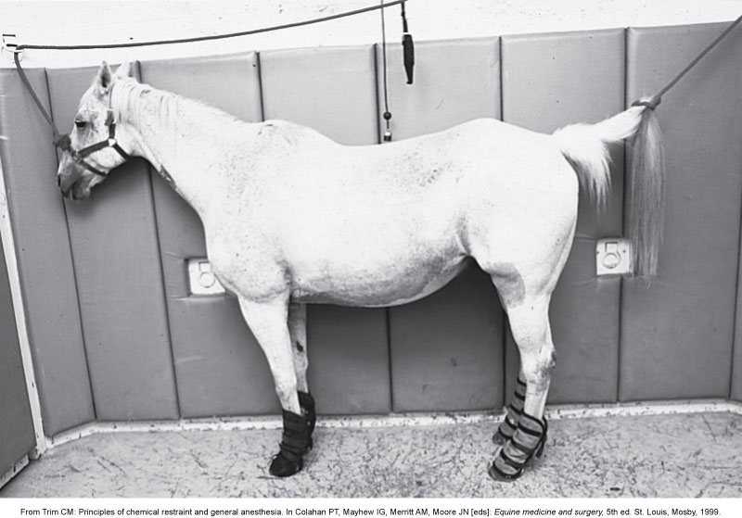
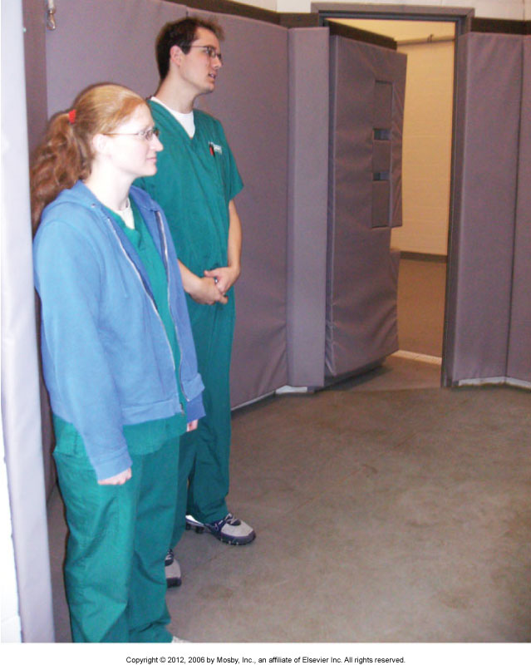
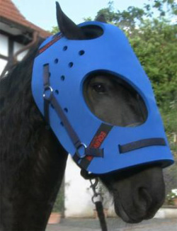

Slide 25
Abdominal Surgery
Ventral midline incision
Clip
  Xiphoid to the udder/prepuce and laterally to each flank fold
Purse-string suture or place several towel clamps to close the prepuce
  Pack with 4 × 4 gauze

Slide 26
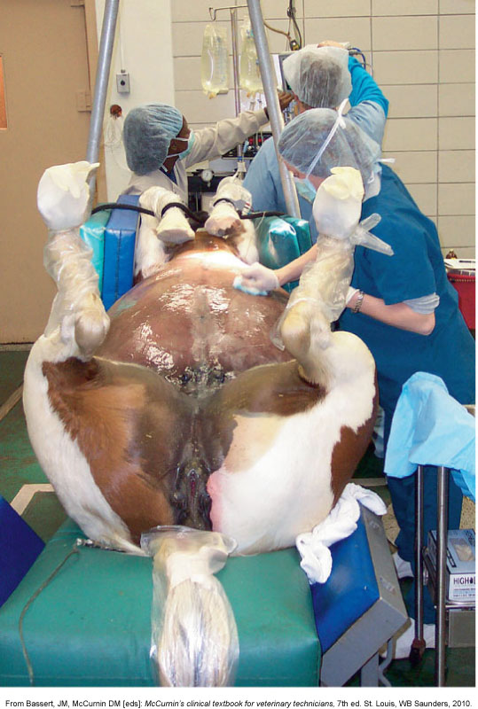

Slide 27
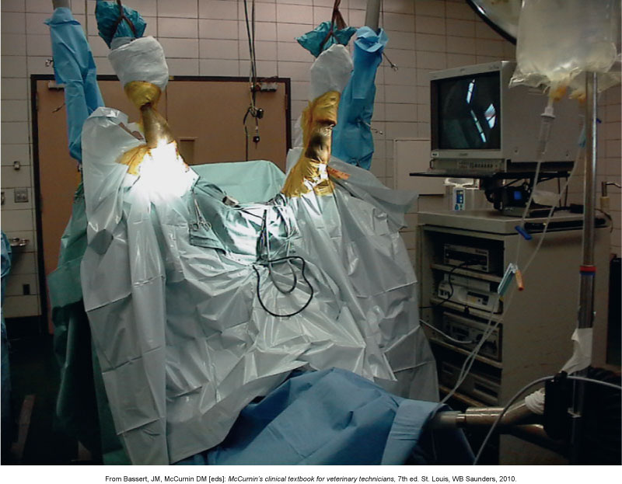

Slide 28
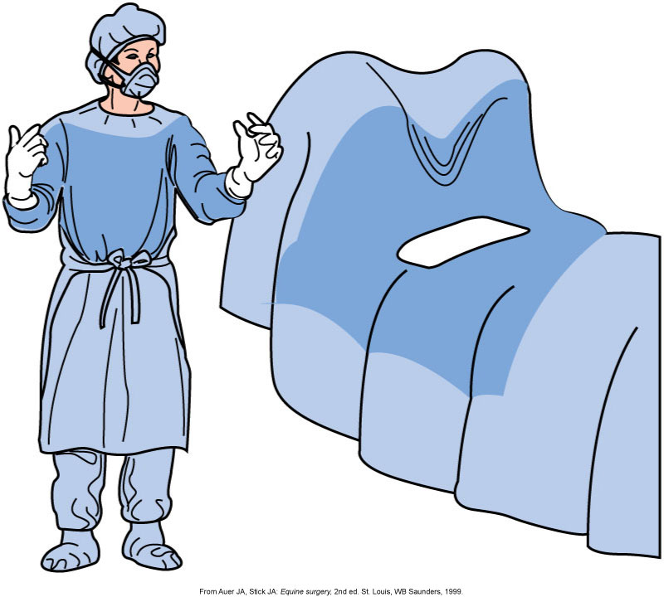

Slide 29
