Slide 1
Wound Management and
Equine Surgical Procedures

Slide 2
Objectives
Understand the basic differences between standing surgical procedures and general anesthesia procedures.
Prepare a patient for surgery.
Assist with or perform induction and maintenance of anesthesia.
Provide anesthetic monitoring.
Manage the patient during recovery and immediate postoperative periods.
Understand the basic risks and possible complications associated with anesthesia and surgery, and implement preventative measures when indicated.

Slide 3
Equine Surgery
Availability of surgical procedures
  Availability of surgical facilities
  Expertise of available surgeons
  Patient health status
  Ability to provide aftercare and follow-up
  Prognosis
  Economic constraints

Slide 4
Equine Surgery (cont’d)
Standing surgery procedures
  Most common
  In the patient’s best interest if possible
General anesthesia (recumbent) procedures

Slide 5
Wound Types
Abrasions- partial thickness wounds (road rash, scraped knees). They can be large and become quite contaminated, but they do not fully penetrated all the layers of the skin
Puncture wounds- result from penetration with foreign objects- commonly nails, tree branches, or pieces of wire. They are narrow in diameter relative to their depth
Lacerations- full thickness wounds that transect the skin completely and often extend into underlying tissues.

Slide 6
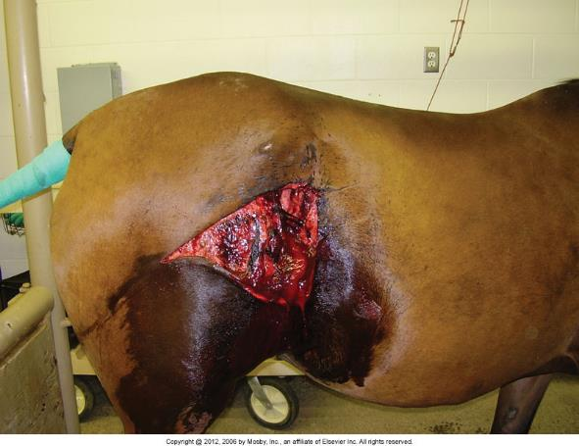
Equine Surgery (cont’d)

Slide 7
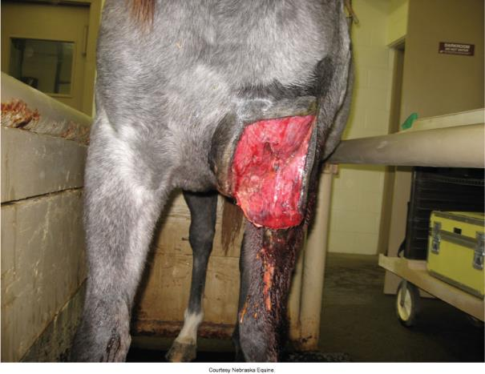
Equine Surgery (cont’d)

Slide 8
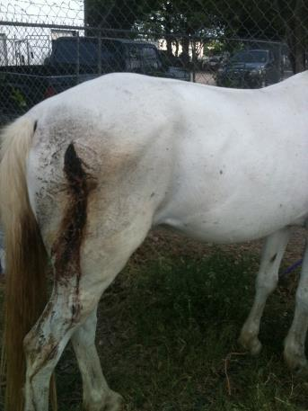
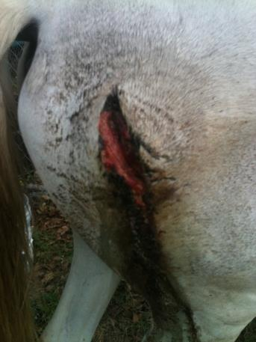

Slide 9
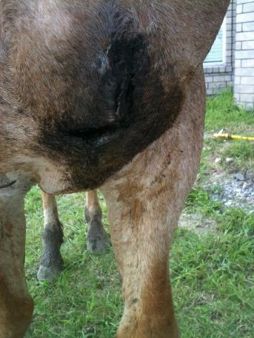
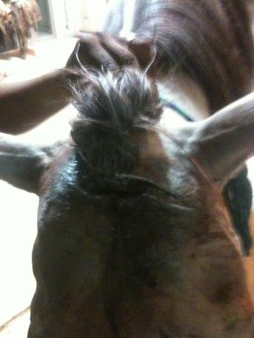

Slide 10
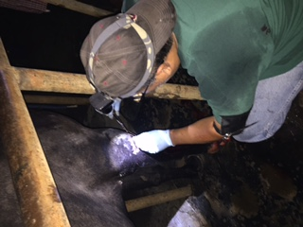
Standing Surgery
Must be safe
Beneficial for sick, debilitated, or elderly patients
None of the risks of recumbent anesthesia
History of problems under general anesthesia
Less expensive

Slide 11
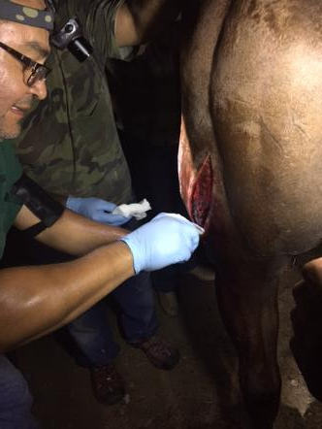
Standing Surgery (cont’d)
Drawbacks
  Surgeon comfort
  Surgeon’s visualization of the surgical field
  Difficult to maintain sterile field
  The patient can move

Slide 12
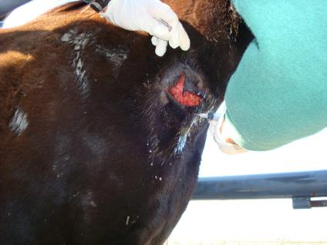
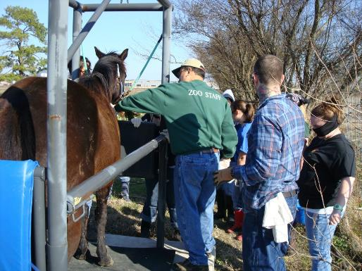
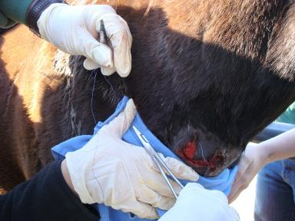
Standing Surgery (cont’d)
Show pictures N Royals

Slide 13
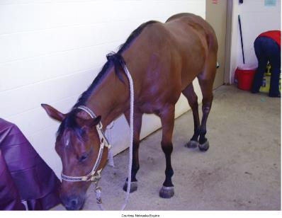
Standing Surgery (cont’d)
Patient preparation
  Withhold grain 12 hours
  Withhold hay for 2 to 6 hours
  Water is not withheld

Slide 14
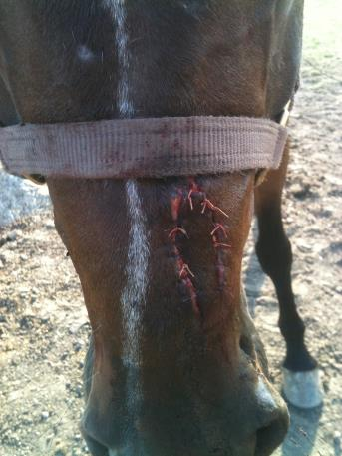
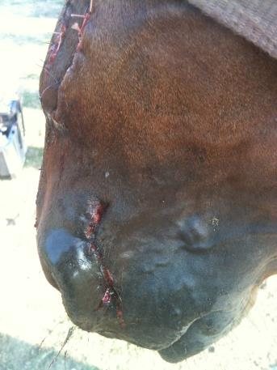

Slide 15
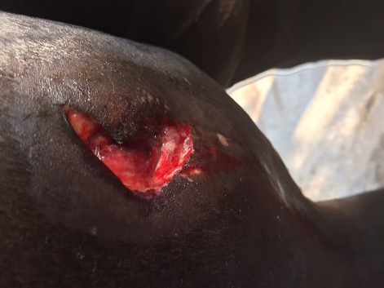
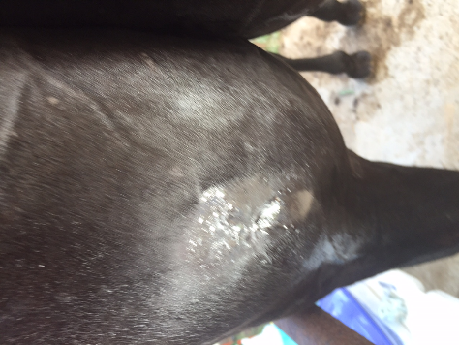
Gored by a bull

Slide 16
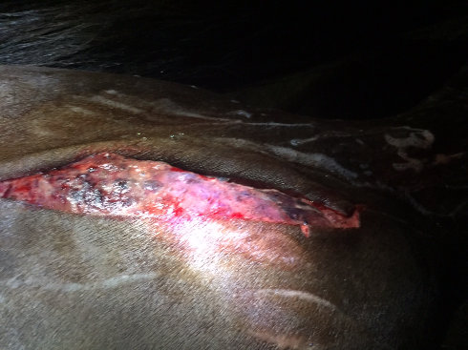
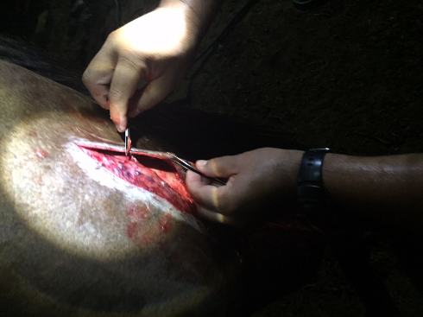

Slide 17
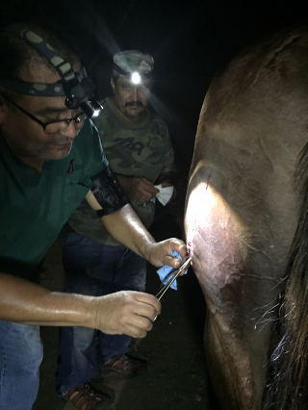
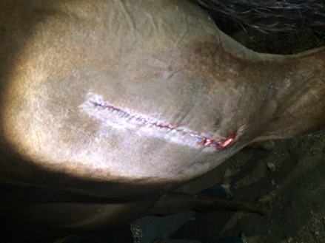

Slide 18
Why Castration?
Removal of the testicles reduces or prevents sexual behavior and aggressive behavior and prevents reproduction by individuals judged to have inferior or undesirable genetic traits.
Treats certain malignancies, testicular trauma, or inguinal or scrotal hernias.
Most commonly done between 1 and 2 yrs

Slide 19
Prerequisite for Castration
You need two fully descended testicles; equines have a high incidence of retained testicles=cryptorchid. Sometimes they are located in the abdomen or the inguinal area. Retained testicles do not produce sperm as the temperature in the body is too high.
Retained testicles do produce testosterone and these horses will exhibit stallion like behavior.
Retained abdominal testicles can become tumorous.

Slide 20
Castration (cont’d)
Age
  12 to 24 months of age
  Can be done later to see how it develops
Anesthesia
  Standing castration
    Tranquilizers
    Local anesthetics, directly into the testicles and the spermatic cord using a long 18- to 20-gauge needle.
  Recumbent animals
    Triple double combination of ketamine-xylazine (KX)
    Ketamine
    Thiopental

Slide 21
Castration (cont’d)
Prepping
  The recumbent animal will have its legs tied or held out of the way.
  Hold the head down on the recumbent animal; may want to put towel over the animal’s eye.
  No clipping or shaving is necessary.
  Scrub the surgical area.

Slide 22
Castration (cont’d)
Procedure
  Closed castration
    Spermatic cord and vaginal tunic are emasculated.
    Greater chance that a vessel will emasculate improperly for this procedure; more bleeding.
  Open castration
    Incision is made over each testicle.
    Dissecting out the testis and the spermatic cord separating them from the common vaginal tunic.
    The spermatic cord is then crushed with the emasculators, and the testicles are torn away.

Slide 23
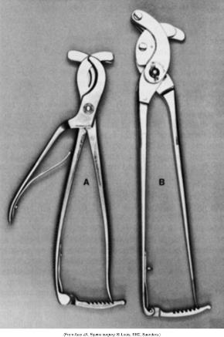
Emasculators
Reimer (A) and Serra (B) emasculators. (From Auer JA: Equine surgery, St Louis, 1992, Saunders.)

Slide 24
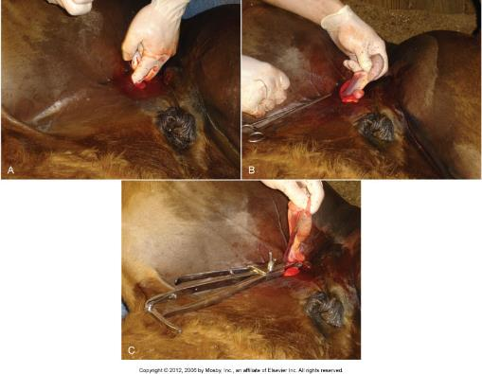

Slide 25
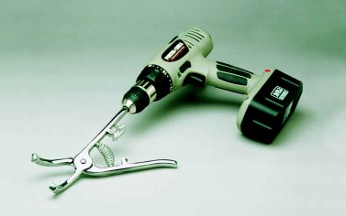
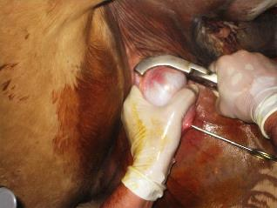
Castration Henderson tool

Slide 26
Castration video..

Slide 27
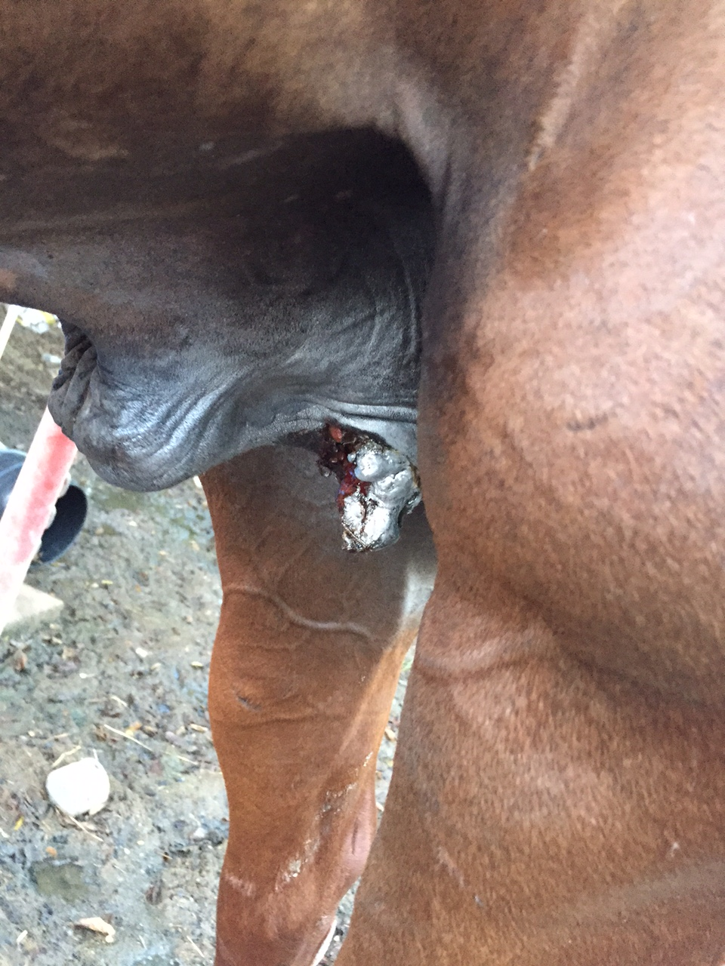
Castration (cont’d)
Postoperative care
  Check for hemorrhaging for several hours after.
  Recheck site periodically for one week for bleeding or swelling.
  Exercise two times a day until healed, as this will promote drainage and healing.
  If needed, rinse with hose to open and promote drainage.
  Separate from other horses until healed.
  Fly control is very important (spring or fall).
  No medications should be needed.

Slide 28
Castration (cont’d)
Complications from castrations
  Severe hemorrhaging
  Excessive swelling from inadequate drainage
  Acute wound infection and septicemia
  Protrusion of abdominal viscera
  Persistent masculine behavior

Slide 29
Standing Surgery (cont’d)
Clean quiet place
Surgical instruments within reach but away from the horse
Restraint: Halter and lead

Slide 30
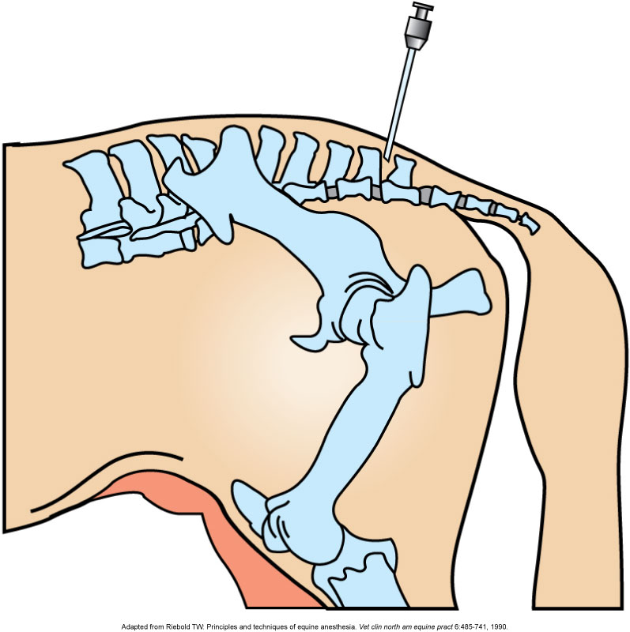
Standing Surgery (cont’d)
Nerve blocks
Field blocks
Epidural anesthesia
Intercoccygeal
Space

