Slide 1
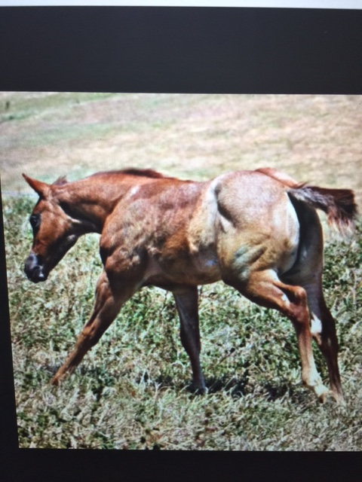
HYPP
Hyperkalemic Periodic Paralaysis
M. BRANTLEY, LVT

Slide 2
HYPP DEFINED:
Equine Hyperkalemic Periodic Paralysis Disease (HYPP) is a muscular disease caused by an inherited genetic mutation. HYPP has been traced back to one horse named Impressive and has the alternative name, Impressive Syndrome, named after this horse.

Slide 3
WHAT IS THE CAUSE??
A point mutation in DNA exists in the sodium channel gene, which codes for an abnormal channel to be expressed in skeletal muscle. This mutation is passed on to offspring.
Sodium channels are “pores” in the muscle cell membrane which control contraction of the muscle fibers. When the defective sodium channel gene is present, the channel becomes “leaky” and makes the muscle overly excitable and contract involuntarily. The channel become “leaky” when potassium levels fluctuate in the blood. This may occur with fasting followed by consumption of a high potassium feed such as alfalfa. Hyperkalemia, which is an excessive amount of potassium in the blood, causes the muscles in the horse to contract more readily than normal. This makes the horse susceptible to sporadic episodes of muscle tremors or paralysis.

Slide 4
SYMPTOMS AND CS:
Symptoms of HYPP may include muscle twitching, unpredictable paralysis attacks which can lead to sudden death, and respiratory noises. Severity of attacks varies from unnoticeable to collapse or sudden death. The cause of death is usually respiratory failure and/or cardiac arrest.

Slide 5
IT IS DOMINANT DISORDER
Because HYPP is dominant disorder, the effects of it can also be transposed to other breeds of horses when intermixing occurs. This makes the recognition of this disorder very important in preserving the inherited health of all horses.

Slide 6
BREEDS AFFECTED
USUALLY:
Quarter Horses OR any horse with Quarter Horse blood.
PRIMARILY BUT NOT LIMITED TO THE HALTER HORSE INDUSTRY.

Slide 7
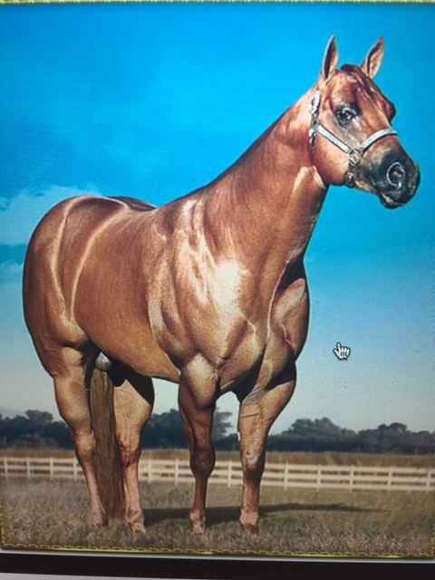
MUSCLE MUSCLE MUSCLE

Slide 8
Dominant HYPP Gene
H/H Affected ----Positive for dominant HYPP gene, indicates the animal carries two inherited copies. Homozygous HYPP horses are genetically bound to pass the gene to 100% of their progeny when bred and all foals will be HYPP horses.
n/H Affected----Both the normal and HYPP alleles were detected. Horse tested heterozygous for HYPP. The horse is affected with the HYPP genetic disorder and there is a 50% chance this horse will pass a HYPP allele to its offspring.
n/n Negative-----Horse tested negative for the gene mutation that causes HYPP and will not pass on the defective gene to its offspring.

Slide 9
HOW IS IT SPREAD:
HYPP is an autosomal dominant genetic trait, which means only one copy of the gene is required to produce the disease.
The disease can equally occur in both sexes (mare, gelding and stallion).

Slide 10
PREVENTION:
During a severe attack of HYPP, emergency treatment from a veterinarian is necessary. For long term therapy, many horses can be managed by exercise and diet control alone. Regular exercise and access to a large paddock or pasture is preferred over stall confinement. Maintain a regular feeding schedule, preferably equally spaced, two to three times per day. Avoid rapid changes in feed, such as bringing a horse off pasture grass and immediately switching to alfalfa hay. Most horses improve when the potassium content in the diet is decreased.
Like most diseases, an ounce of prevention is worth a pound of cure. ..

Slide 11
TREATMENT
acetazolamide (2-4 mg/kg orally, every 8 to 12 hours)
hydrochlorthiazide (0.5-1 mg/kg orally, every 12 hours)
Like most diseases, an ounce of prevention is worth a pound of cure. ..

Slide 12
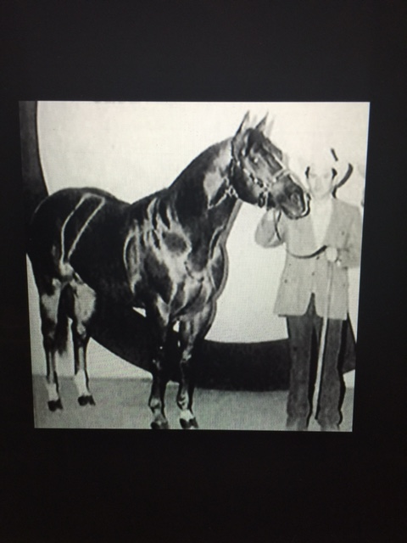
IMPRESSIVE-QUARTER HORSE STALLION

