Slide 3
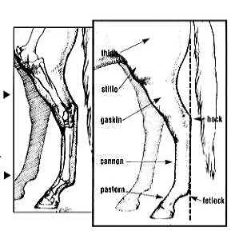

Slide 5
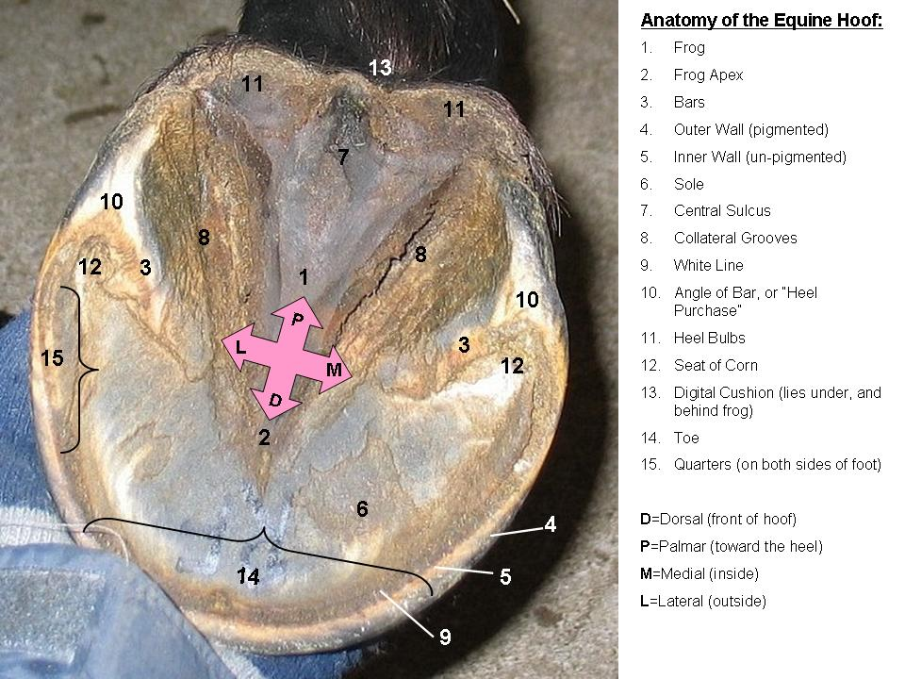

Slide 6
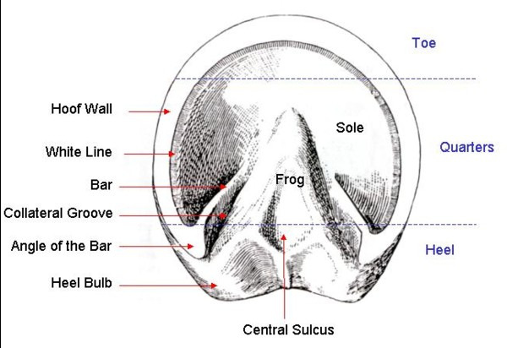

Slide 7
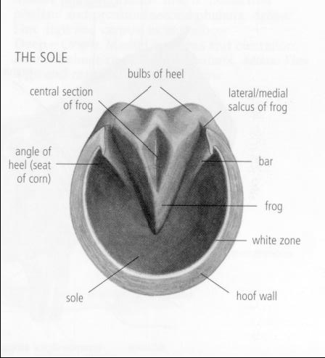
Frog
One of the most important, but often neglected structures of the horse’s hoof. It should be wide and substantial and made up of thick, leathery material. An unhealthy frog is vulnerable to infection which, if left untreated, can lead to significant loss of structure in the back of the hoof causing severe lameness.
The frog works in concert with the coronary band, the bars and the sole to provide resistance to distortion of the hoof capsule during the stride.
Pressure placed upon the frog directly influences the health of the digital cushion above it.
The frog stay (triangular piece cut out of the sole that the frog sits in) allows independent movement at the heels as the horse lands on uneven ground. The frog also plays a part in protecting the sensitive structures beneath, providing traction, assisting circulation and absorbing shock.

Slide 8
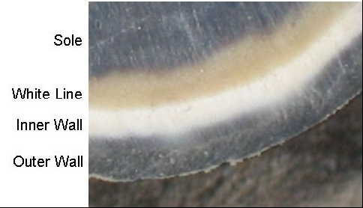
Sole
The sole is the area inside the white line, but not including the bars and frog. It’s primary function is to protect the sensitive structures beneath the sole.
However, the outer perimeter of sole also provides support, sharing some of the weight of the horse with the hoof wall.

Slide 9
White line
The purpose of the Golden Line is to join the sole to the inner wall of the hoof and to seal off the border of the pedal bone to protect it from bacterial infiltration.
It creates a shallow crease at the bottom of the hoof which fills with dirt, aiding with traction.
Should not be penetrated by a nail during shoeing.

Slide 10
Inner Wall
The inner hoof wall is usually white (unlike the outer wall, it does not contain pigment). It is more pliable than the outer wall due to the higher ratio of intertubular horn which bind the tubules together.

Slide 11
Outer Wall
The outer hoof wall is pigmented and contains a higher ratio of tubules. These tube-like structures grow down from the coronary band in a spiral configuration. It has been suggested that this makes them act like tiny springs, but this cannot happen as there is no space between the coils.

Slide 12
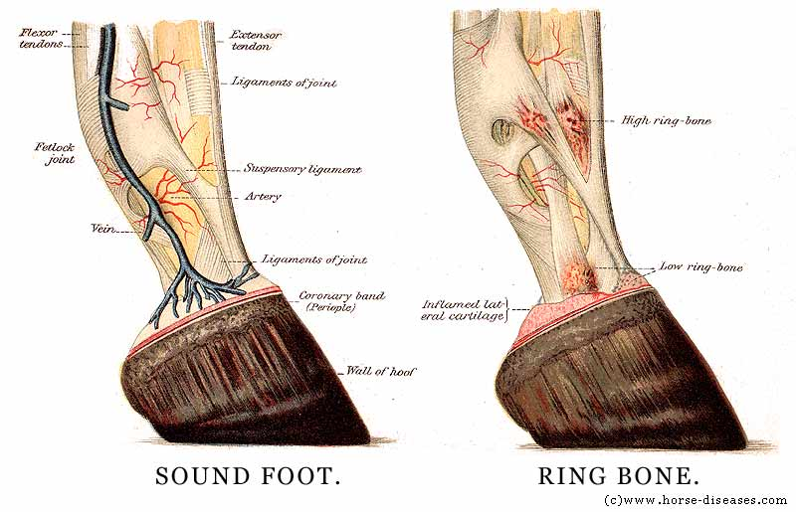

Slide 13
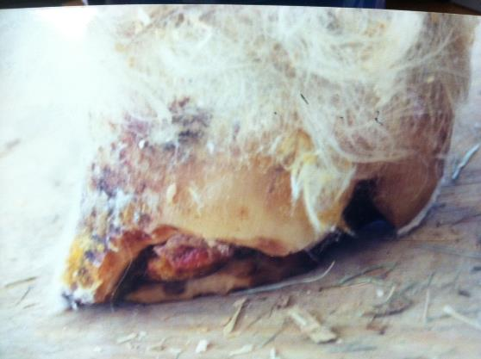
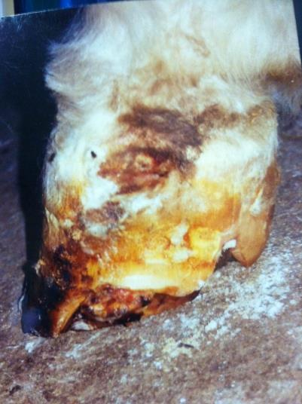
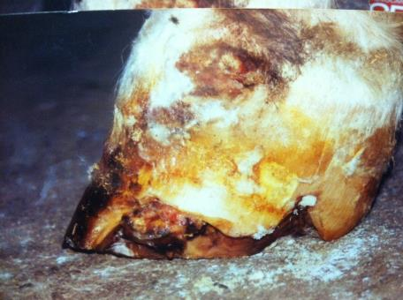

Slide 14
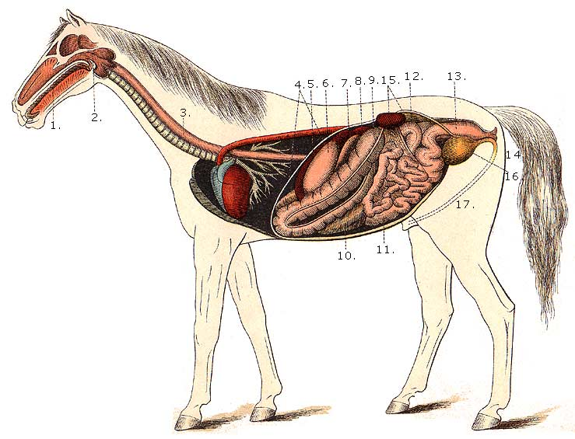
Digestive System
1. Mouth
2. Pharynx
3. Esophagus
4. Diaphragm
5. Spleen
6. Stomach
7. Duodenum
8. Liver, upper extremity
9. Large colon
10. Coecum
11. Small intestine
12. Floating colon
13. Rectum
14. Anus
15. Left kidney and its ureter
16. Bladder
17. Urethra

Slide 16
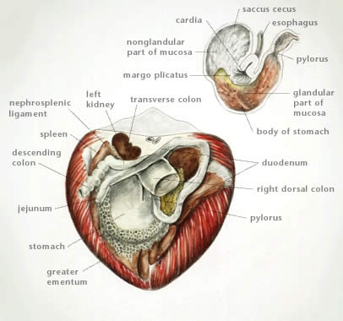
Equine gastrointestinal anatomy
Gallbladder?

