Slide 1
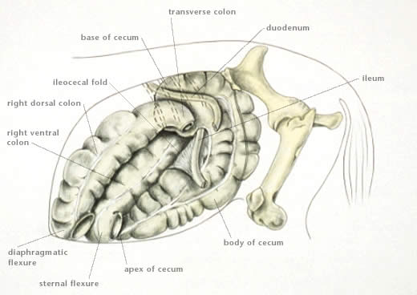
Fermentation occurs on the Cecum and colon.

Slide 2
Mouth -> esophagus-> stomach -> DJI-> Cecum -> Right ventral colon -> sternal flexure -> Left ventral colon -> Pelvic Flexure -> Left dorsal colon ->diaphragmatic flexure-> right dorsal colon -> Transverse colon-> small colon-> Rectum-> out

Slide 3
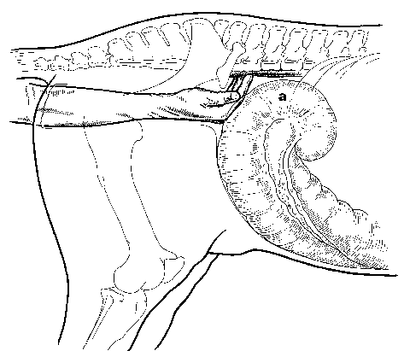
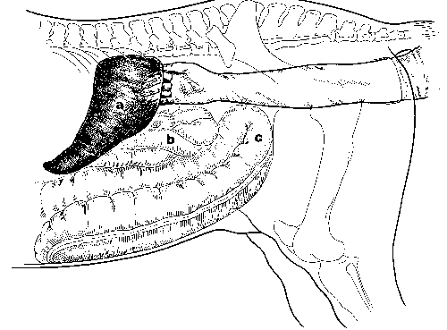
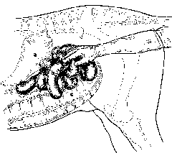
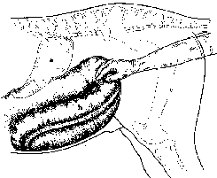
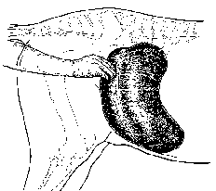
Rectal Palpation
L side: spleen, pelvic flexure,
mesenteric root, L kidney
R side: Aorta, cecum
SI strangulation
Cecal tympany
Large colon impaction

Slide 4
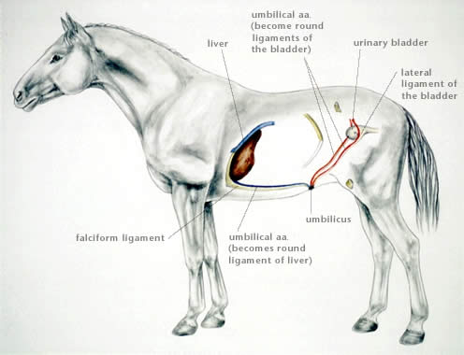
Umbilicus, horse

Slide 5
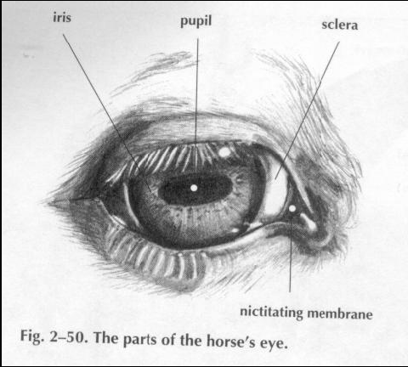

Slide 6

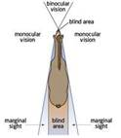
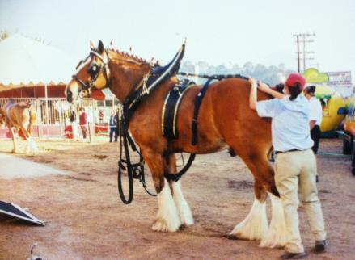
Sight
Large field of vision, almost 300 degree
Blind spots
Good nocturnal vision-
tapetum lucidum

Slide 8
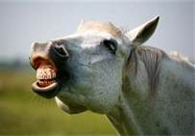
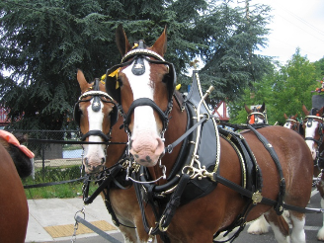

Hearing
Well developed
Eye-ear coordination
Smell
Well developed
Locate food, identify others, etch.
Vomeronasal organ- flehmen response, olfactory receptors

Slide 9
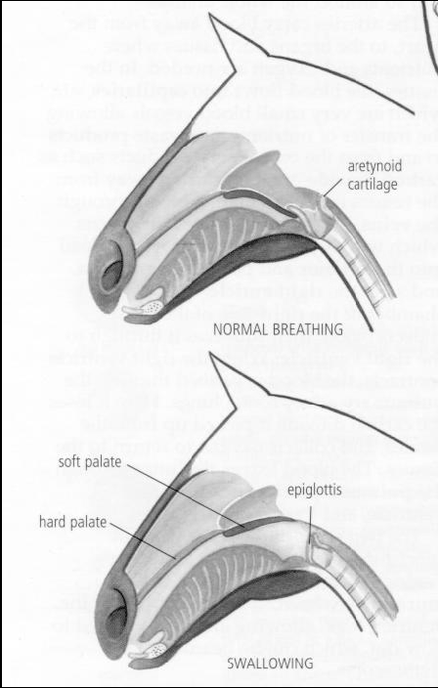

Slide 10
