Slide 1
Lameness exams

Slide 2
Lameness Examination
Reasons for lameness
  Pain-
  Mechanical interference without pain
  Neurological lameness

Slide 3
Components of Examination
  History
  Observation-
    Evaluation at rest- toe touching, or able to bear weight
    Evaluation in motion
  Palpation- feel for heat, or feel for tenderness in the foot
  Local anesthesia
  Further diagnostic evaluation

Slide 4
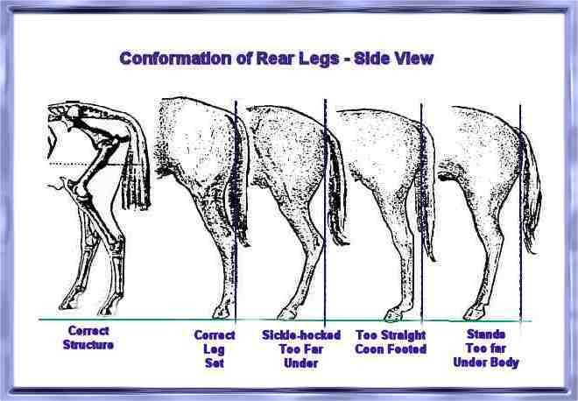

Slide 5
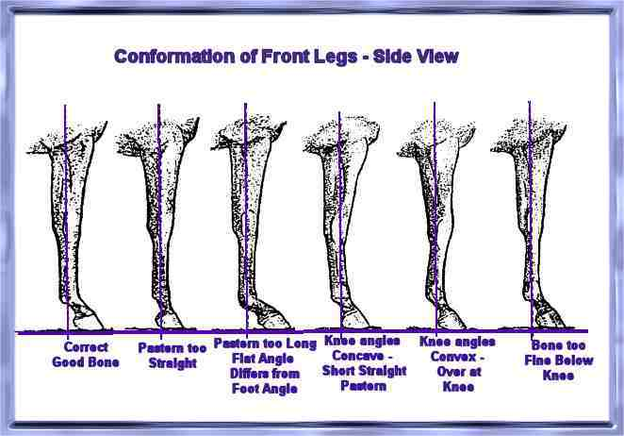

Slide 6
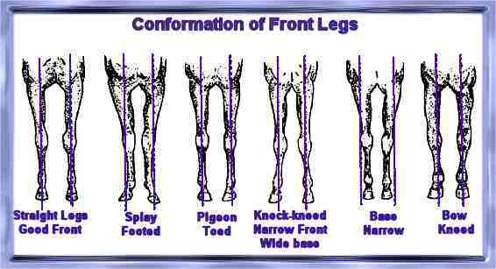

Slide 7
Gait evaluation
Easiest to detect at a trot
Small circles accentuate lameness
Left vs. right
Flexion of fetlock
Head bobbing- up with forelimb, down with hind limb
Stride length
Shoe ware

Slide 8
Lameness grade 0-5
0- not perceptible under any circumstance
1- difficult to observe, inconsistent, regardless of circumstance
2- difficult to observe at walk and trot on straight line, but apparent consistently under certain circumstances (circle, incline, hard surface)
3- consistently observable at trot under all circumstances
4- obvious at walk
5- inability to move- non-weight bearing

Slide 9
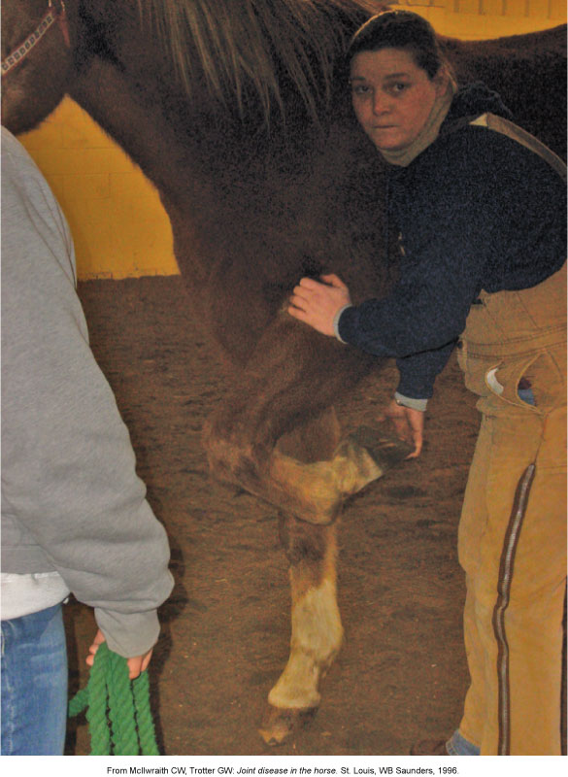
Carpal Flexion Test

Slide 10
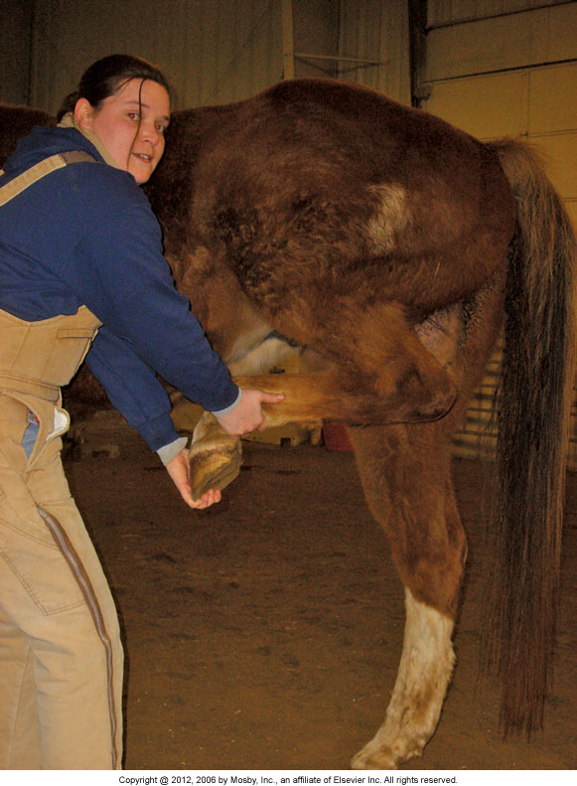

Slide 11
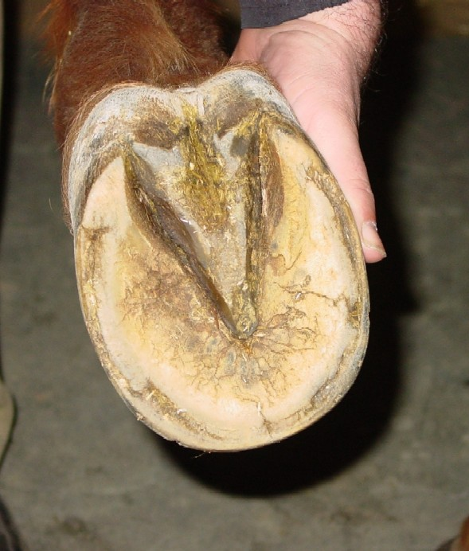
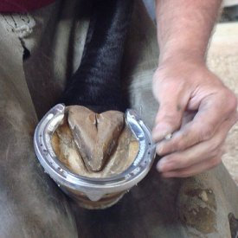
Inspection and Assessment of Foot Conformation and Shoeing

Slide 12
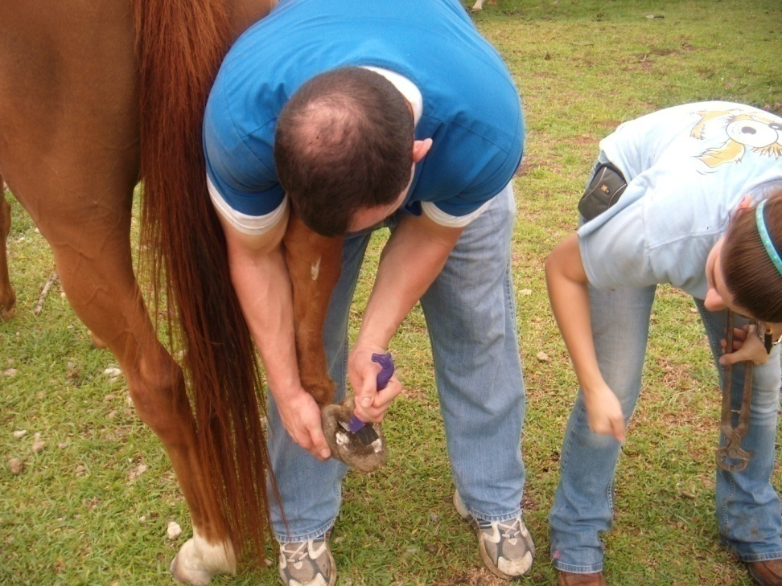
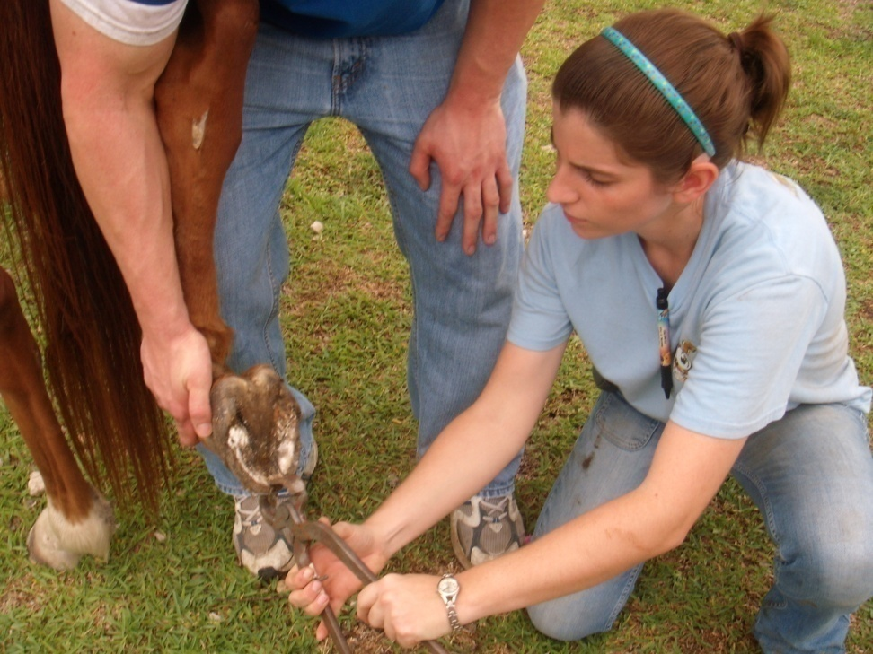
HOOF WORK

Slide 13
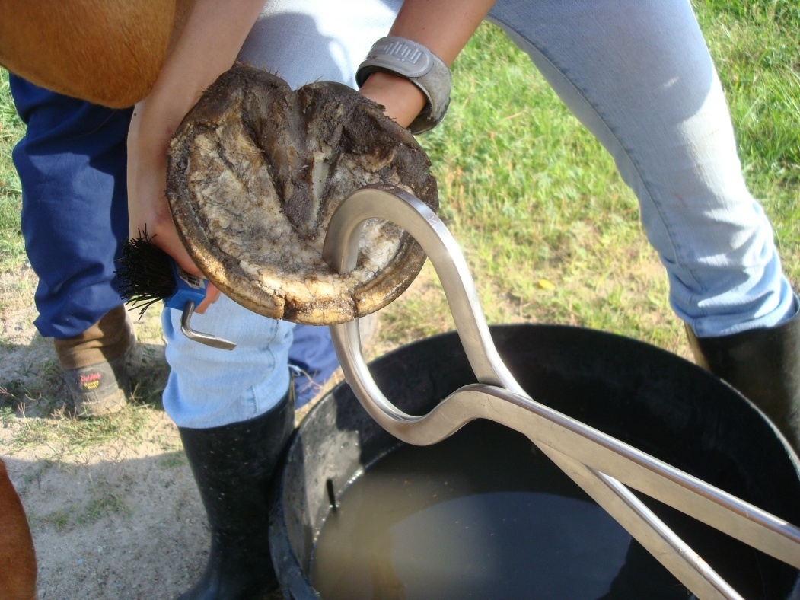
Examination of the hoof using Hoof Tester
The testers are applied between the hoof wall and the sole to find whether pain is present

Slide 14
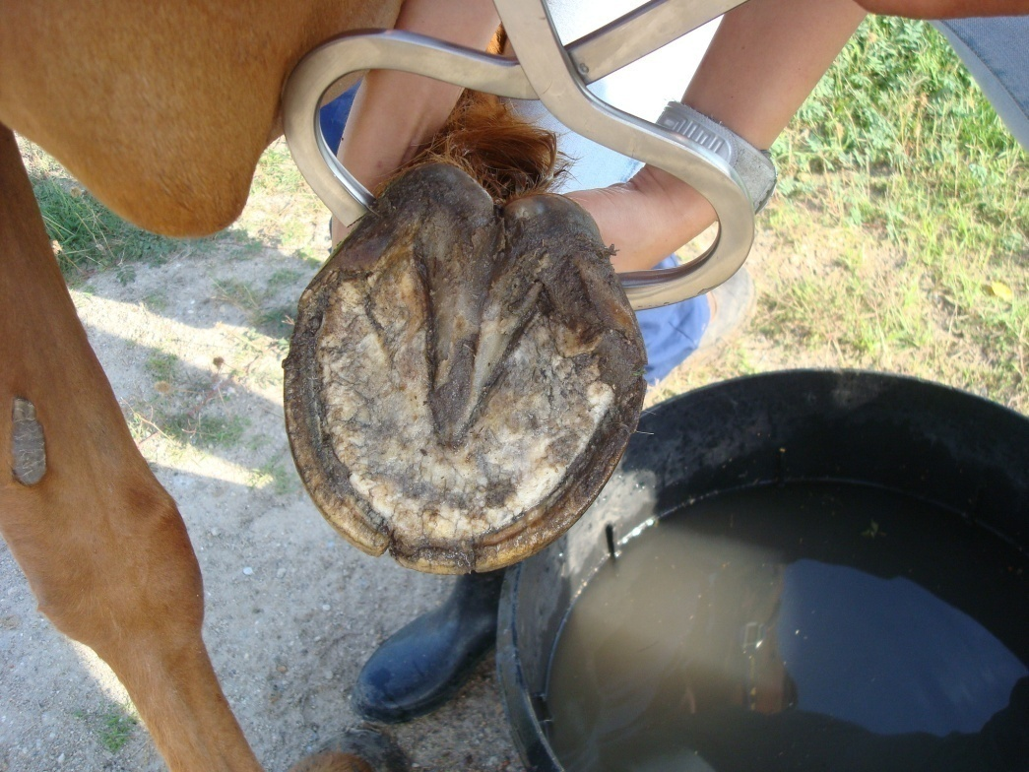
Examination of the hoof using Hoof Tester
The hoof testers are being applied across the heels of the foot to localize pain to the palmar aspect of the foot

Slide 15
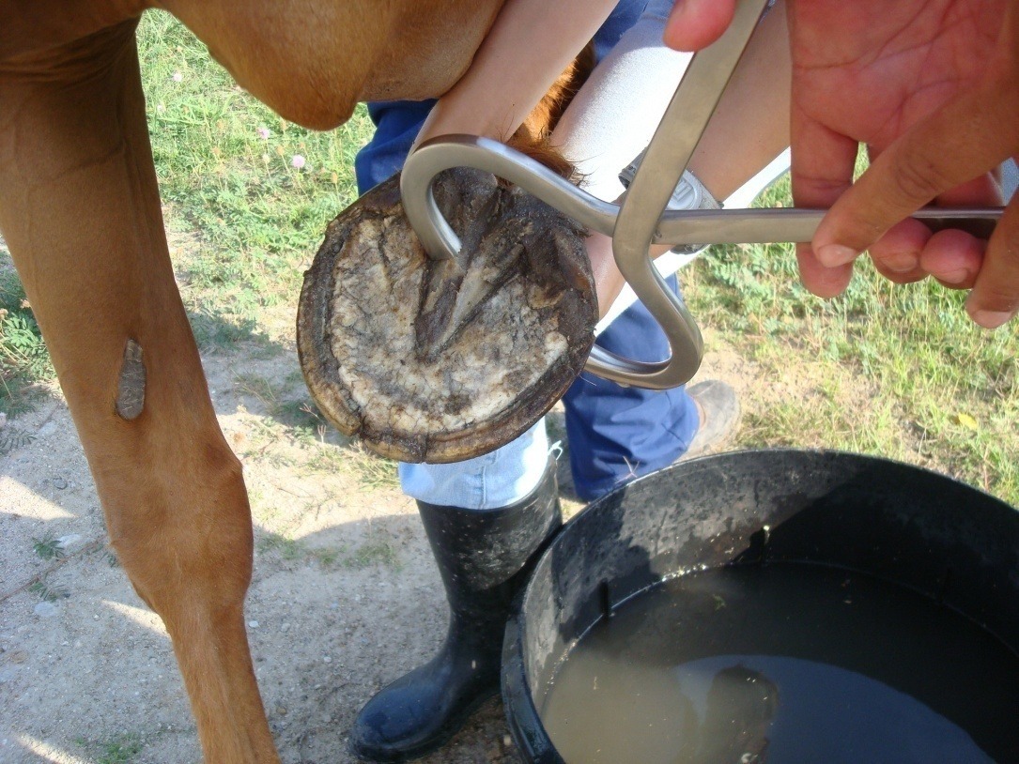
Examination of the hoof using Hoof Tester
The hoof testers are applied over the middle third of the frog. Horses with pain in the navicular region may show pain on application over this area

Slide 16
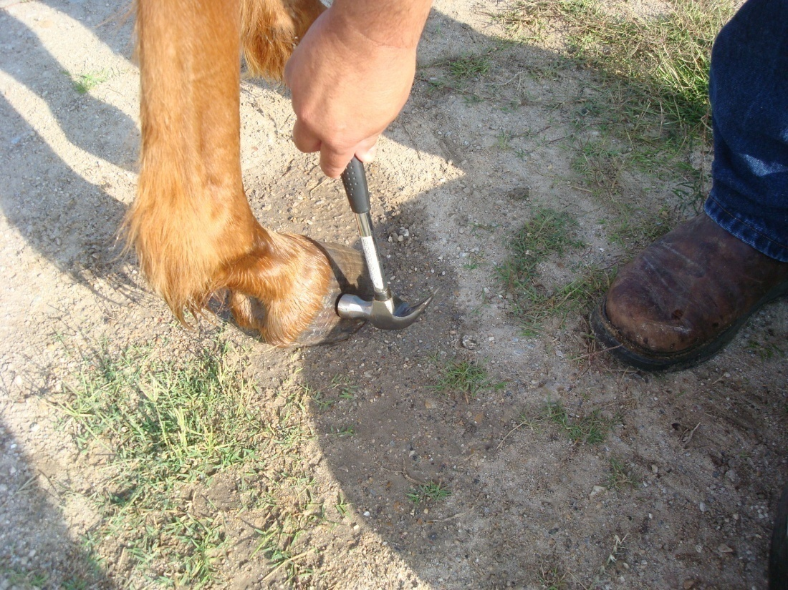
Hoof hammer
Tapping of the hoof wall with a hammer, whit the hoof on the ground. Sometimes this will reveal pain when the use of the hoof testers does not

Slide 17
http://www.youtube.com/watch?v=ICOtTMEuCxY

Slide 18
Other diagnostics
Nerve block
Thermography
Radiography
Ultrasound
Bone scan
Magnetic resonance imaging
Nuclear scintigraphy
Tomography
Arthrocentesis

Slide 19
3 classifications for lameness
  Supporting limb lameness
  swinging limb lameness
  mixed lameness
  complementary/compensatory lameness
  1-PREDISPOSING FACTORS- shoeing, disease, faulty conformation, poor condition, poor hoof care
  2-TRAUMA-trailer, accidents, kicks by another horse, incoordination (cross-fire)
  3-GENETICS

