Slide 1
Equine Medication Techniques

Slide 2
Oral Medications
Feed additives
Dose syringes

Slide 3
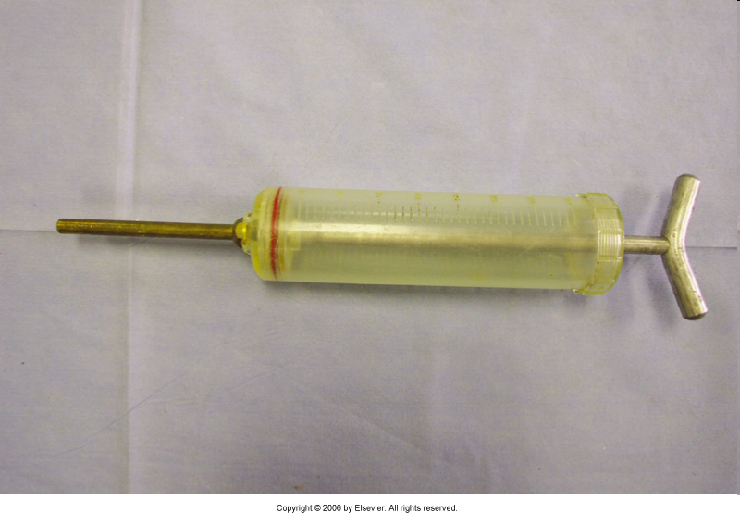
Large dosing syringe

Slide 4
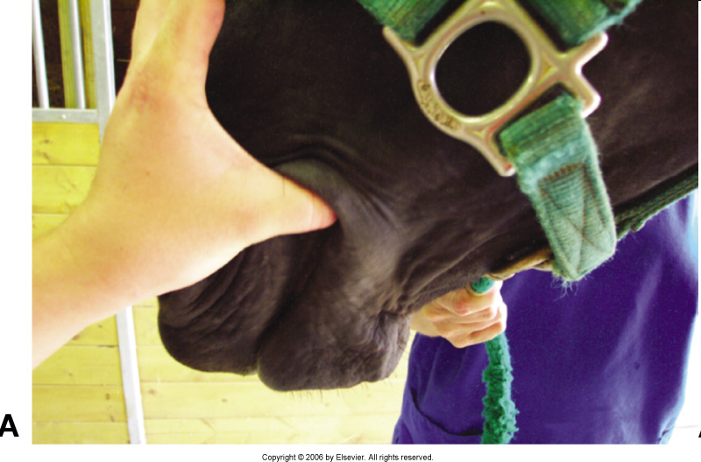
Open the lips first

Slide 5
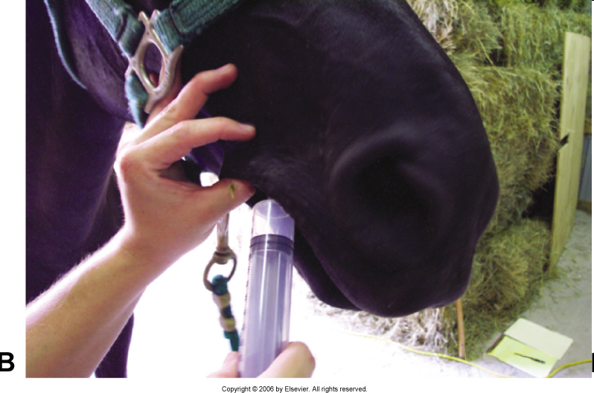
While parting the lips, place the syringe into the lateral far point of the mouth.

Slide 6
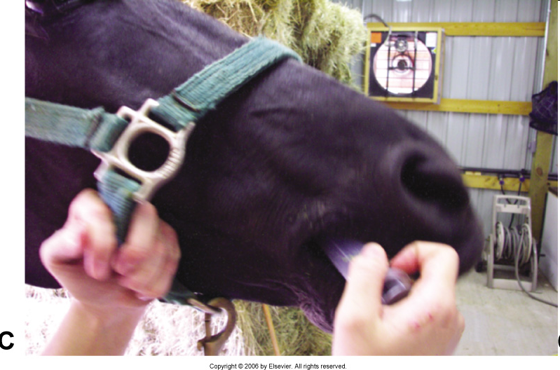
Proper position of the oral syringe

Slide 7
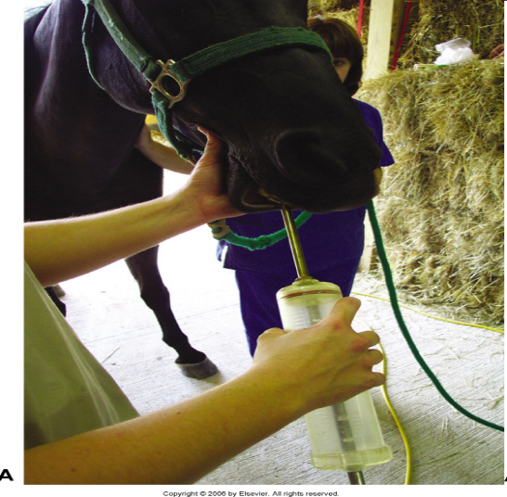
No, No! Don’t place the syringe over the incisors.

Slide 8
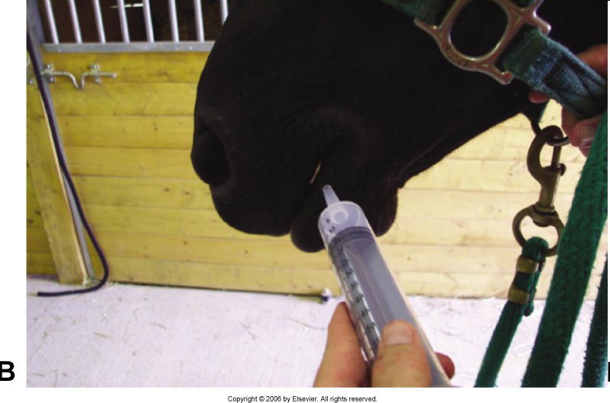
Another No, No. Avoid delivering the medication in the interdental space.

Slide 9
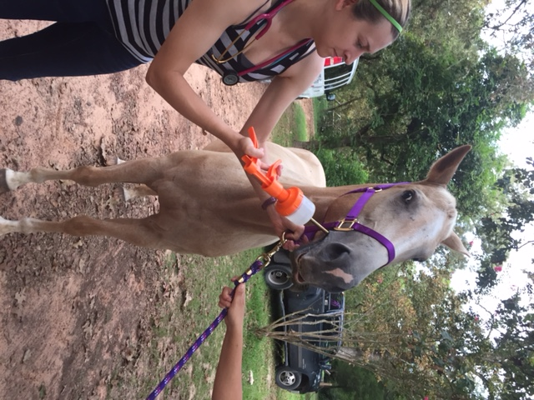

Slide 10
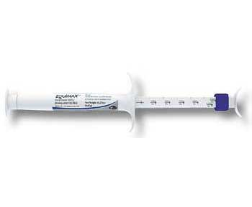
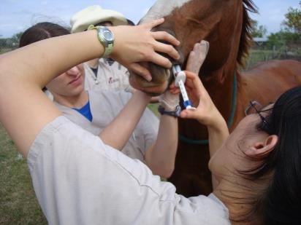
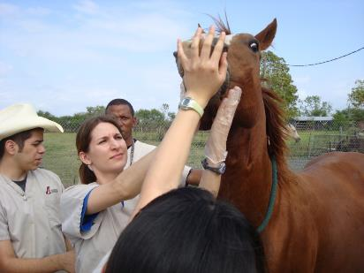
Deworming with a tube paste

Slide 11
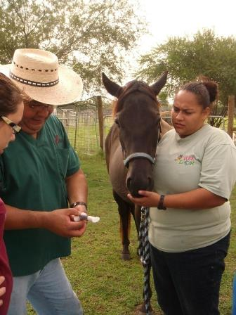
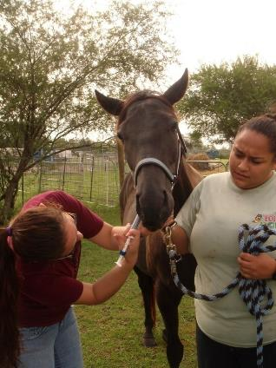
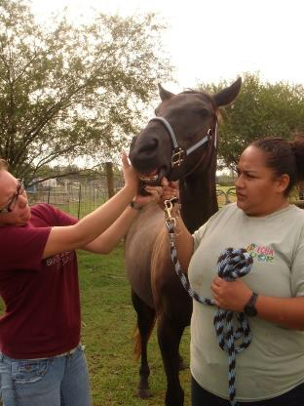
Deworming

Slide 12
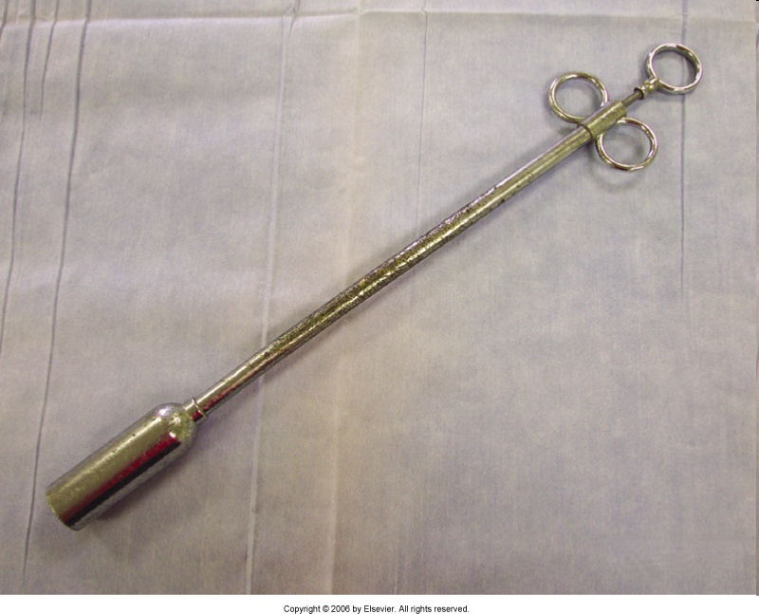
Balling Gun: Used to administer large boluses. Not always a good choice as it is very large and must be placed over the base of the tongue deep far back into the mouth.

Slide 13
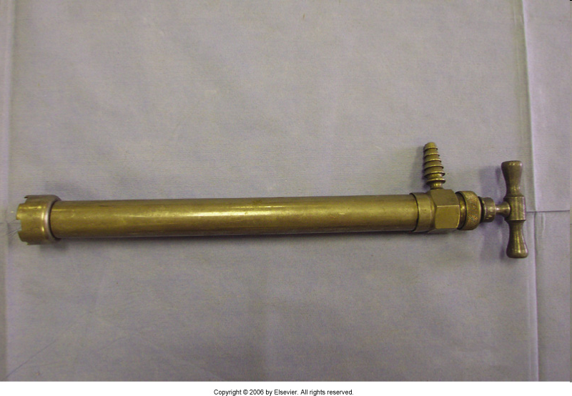
Stomach pump: Very common method of delivering medications or liquids from a bucket or plastic jug.

Slide 14
Stomach Pump Usage
Never force liquids against back pressure into the horse.
The capacity of an avg. 1000 lb horse’s stomach is 4 to 5 gallons. Do not exceed this volume.
Typically, 1 gallon of fluid is the max given at one dosing, though this may be repeated at 30 minute or 1 hour intervals in urgent situations.

Slide 15
Nasogastric Tube
Never place without lubrication.
Mark proper position with tape and attach to halter.
Cap tubes because some clinicians believe that air can enter and cause bloat.

