Slide 1
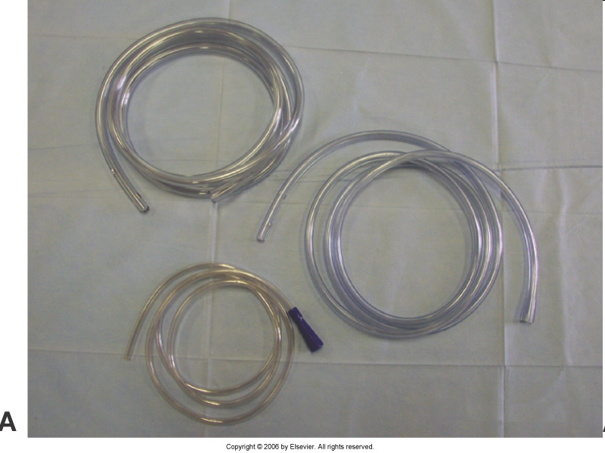
Various Plastic Clear Nasogastric Tubes

Slide 2
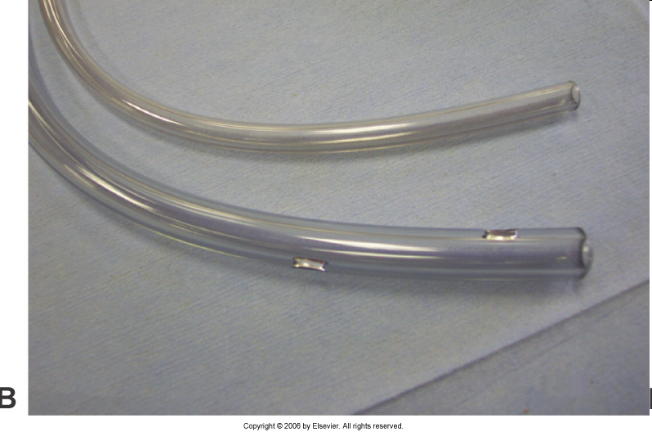
The smaller end goes into the nose.

Slide 3
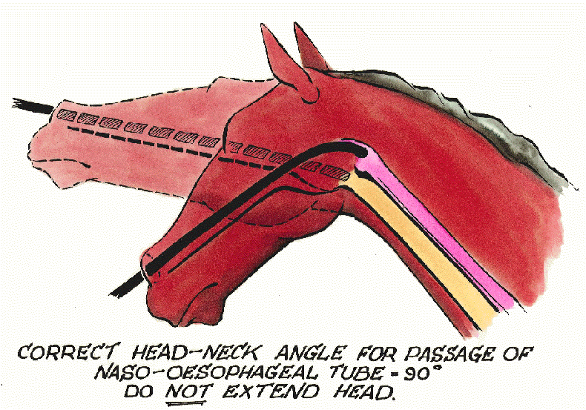
Placing the tube

Slide 4
Nasogastric Tubes
Can be left in place for 24 to 48 hours. Be sure to secure them to the halter with adhesive tape.

Slide 5
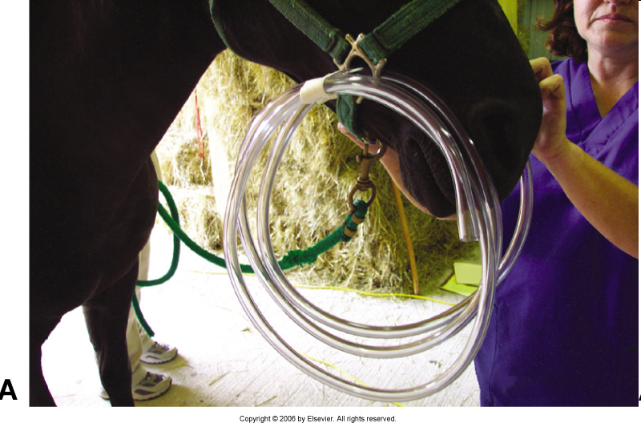
Be sure that the horse can not get his hoof into the tube.

Slide 6
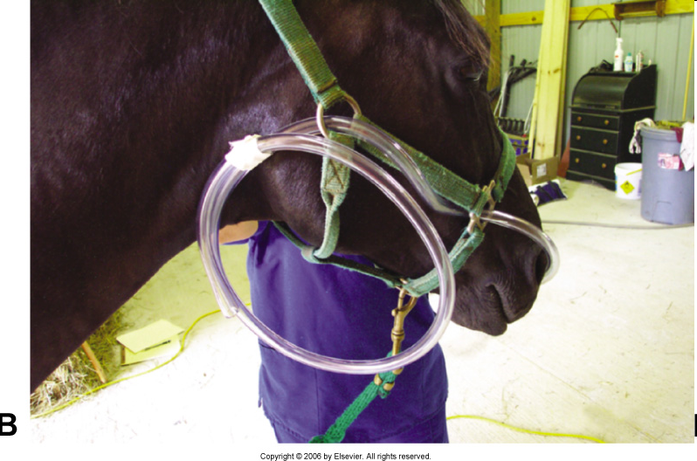
Another view

Slide 7
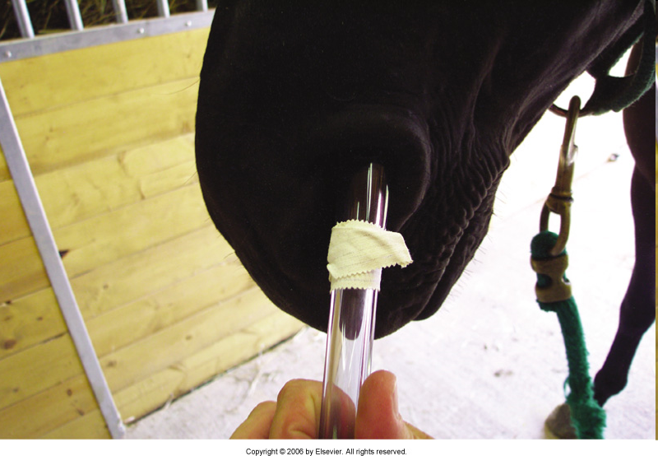
Proper position of the tube is marked with adhesive tape or a sharpie at the level of the nostril.

Slide 8
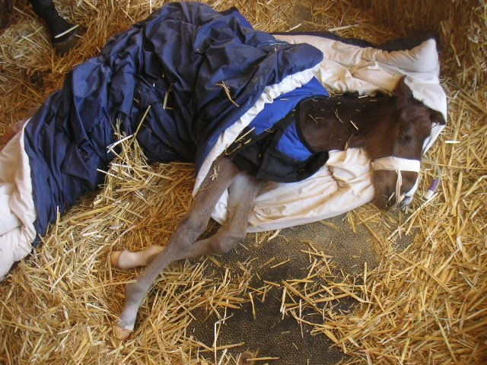

Slide 9
Removing the Nasogastric Tube
Always crimp the tube by folding it over double during removal.
Slowly pull out 12 inches at a time.
Beware of nosebleeds.
Be watchful of the horse as it may buck it’s head.

Slide 10
Why crimp the tube?
Often there is liquid material inside the tube. This liquid can be inhaled back into the lungs of the horse and they can develop aspirate pneumonia.

Slide 11
Parenteral Injection Techniques
LACP, page 205

Slide 12
FDA
Did you know that the FDA has a say-so regarding injection sites for horses?
ALWAYS read the directions listed on the label of all medications before administering. The FDA has approved specific sites for medications to equines.

Slide 13
Route Selection depends upon:
Your capabilities
Tractability (how easy this can be done) of the patient
Toxicities of the medication
Temperament of the patient

Slide 14
Parenteral Injection Techniques: Most Commonly Routes used
IM (Strictly speaking, any skeletal muscle that can be accessed safely can be used for an IM injection. However we will discuss the most commonly utilized muscles.)
IV
SQ or SC
ID

Slide 15
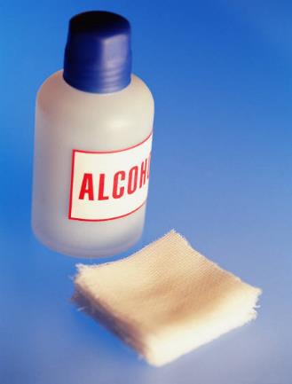
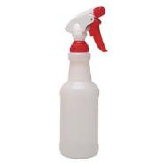
Make Use of the Alcohol
Always use alcohol soaked cotton balls aka alcobals or gauze when administering injections.
Don’t just wet the fur but get down to the skin as well. Clean the site until your cotton or gauze is essentially clean. Clear that area!

Slide 16
Injections
Intramuscular
Most common type used in horses
  18- to 22-gauge needles with length of 1 to 1 1/2 inches; 18 for thicker solutions and 20 for thinner
  Maximum volume per injection site: 15 ml
  Pectoral and semitendinosus: 5 to 10 ml
  Draft horses can be increased by 5 ml per location

Slide 17
Intramuscular Injections
Brachiocephalicus-neck
Pectoral
Gluteal –no for race horses
Semitendinosis
Triceps Brachii-used ONLY when all other sites have been exhausted! No for race horses

Slide 18
Steps for an IM Injection
1. Know the type of drug needed, route of administration, dosage, drug handling precautions, and adverse drug reactions (READ, READ, READ).
2. Read the drug label.
3. Use only sterile needles and syringes.
4. Untie the horse if you are not sure of its reaction.
5. Insert the needle straight into the muscle and up to the hub.
6. Attach the syringe to the needle.
7. Aspirate (pull back) on the plunger. If the blood appears in the syringe, remove the needle and try again with a clean one.
8. Slowly inject the medication.
9. Observe the horse for signs of adverse reactions. Make sure you have epinephrine ready for injection in case of anaphylactic shock.
10. Properly dispose of your needle and syringe in a medical waste container.

Slide 19
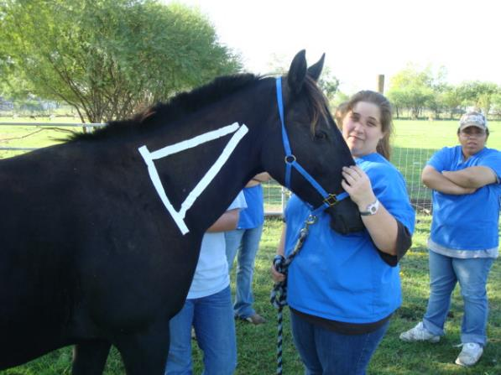
This is your land mark for the lateral cervical area (neck) in the brachiocephalicus or serratus ventralis muscle for IM injections.

Slide 20
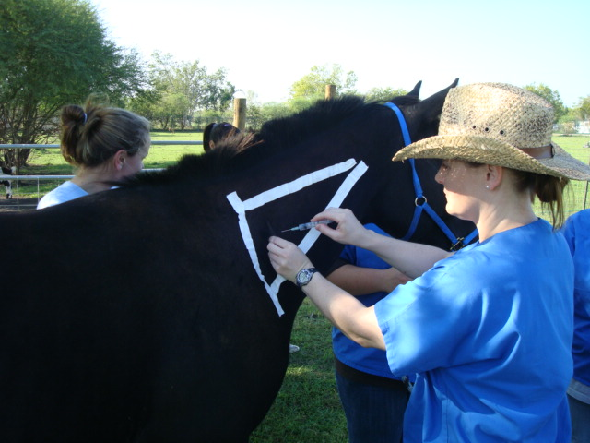
IM injection into the equine cervical muscles. The needle should be inserted to its full depth. Aspirate, and then the medication is delivered.

Slide 21
Please, Please…
Aspirating is done for one important reason.
You need to make sure that you are not in a blood vessel. What difference will this make?
If you just so happen to administer a medication that is only for IM use into a blood vessel you can KILL that animal. This is VERY important with all animals. There are some medications that simple can not be administered IV.
Observe for reactions (pruritus, facial edema, hives or urticaria-hives)

Slide 22
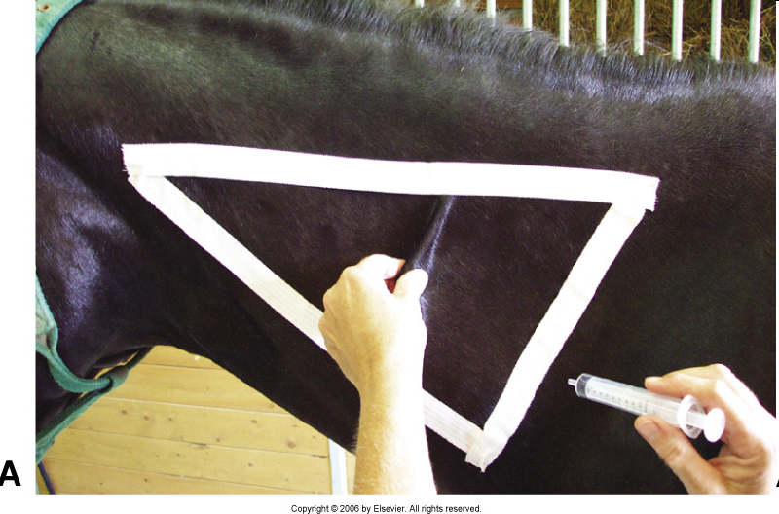
Pinching of the skin sometimes distracts from the pain of the needle and can act as a bandage over the actual needle track.

Slide 23
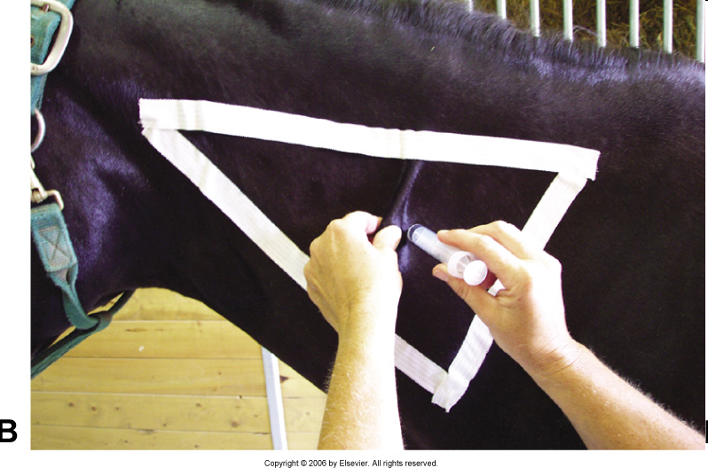
Insert the needle about 1 to 2 inches caudal to the skin pinch.

