Slide 1
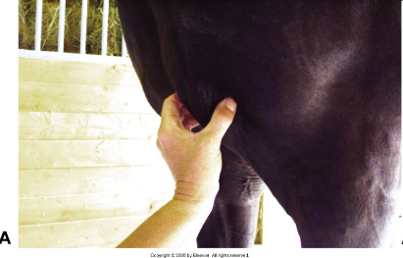
Pectoral muscle IM injection location. Isolating the muscle.

Slide 2
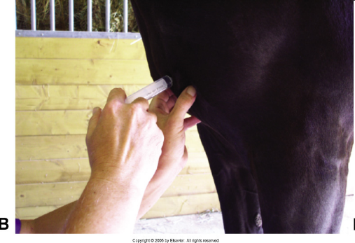
Giving the IM injection. Personally I do not prefer this site due to the location.

Slide 3
Injections (cont’d)
Buttocks
  Preferred for foals
  Puts handler within kicking range
  Can also be done on top
    Although abscesses are hard to drain

Slide 4
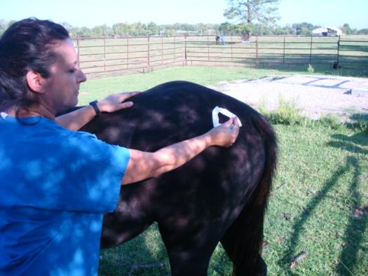
Insertion of the needle into the gluteal muscle.

Slide 5
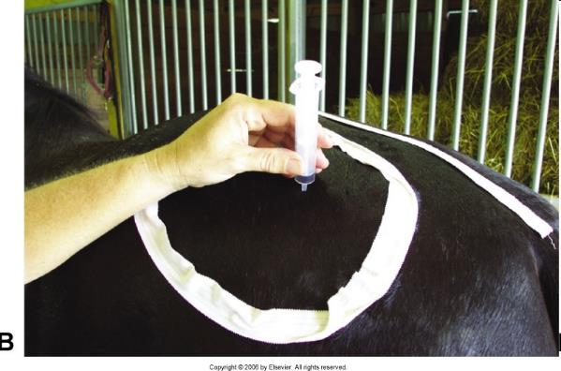
Attachment of the syringe AFTER insertion of the needle.

Slide 6
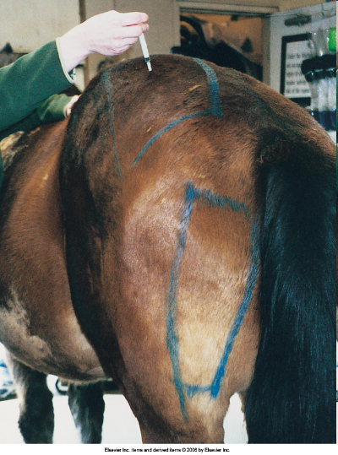
The gluteal region
may be used for
IM Injections, but
the pectoral or
semimembranosis/
semitendinosis
muscles are
preferred sites for
IM injections.

Slide 7
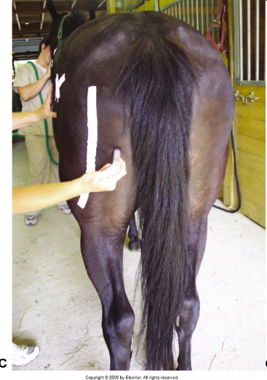
The white tape
Represents the
Sciatic groove,
Hitting this can
Paralyze an animal.
This is the proper
Technique for giving
An IM injection into
The semitendinosis
Injection.

Slide 8
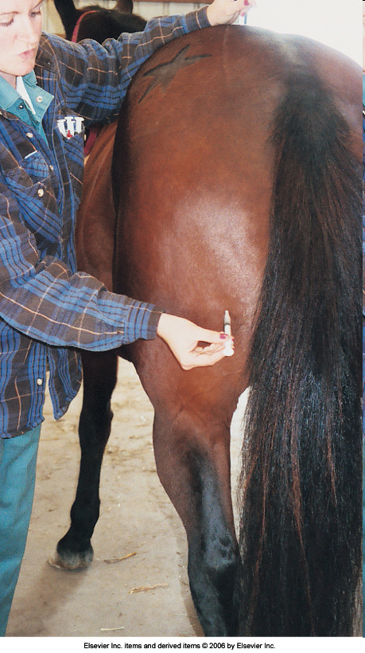
IM injection into the
Semimembranosis
and
Semitendinosis
Muscles in the horse.

Slide 9
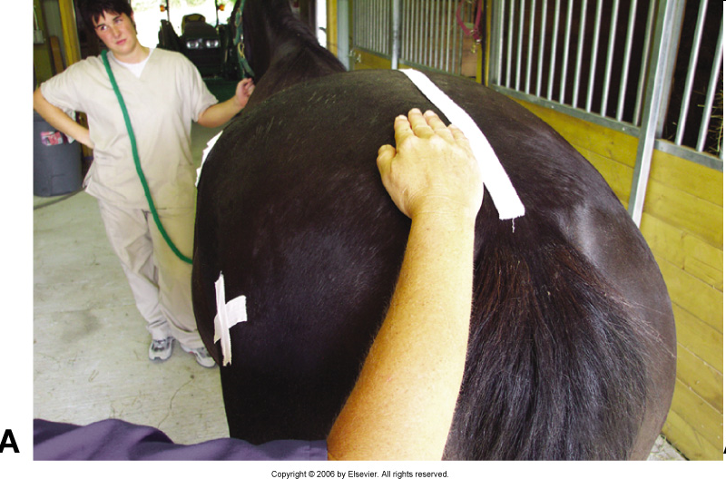
Landmark lateral to the spine. Look closely at this picture. What is wrong?

Slide 10
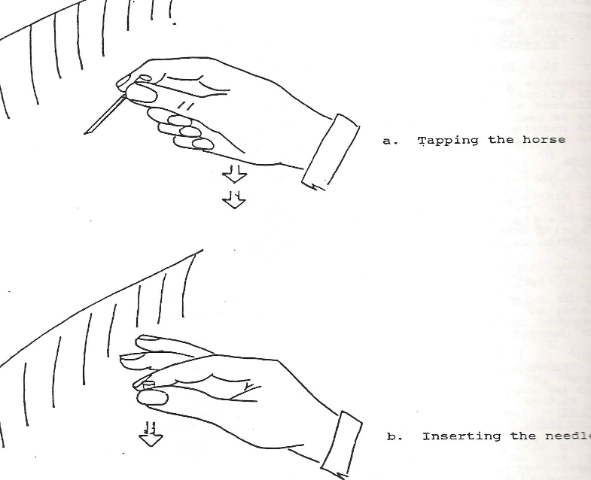
Tap, Tap
With your
Palm
Go Now!
Insert the needle!

Slide 11
Intravenous Injections
Can be given into any visible or palpable vein, safely.
The jugular vein is the most accessible, safest and popular vein used today.

Slide 12
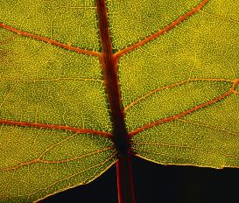
Injections (cont’d)
  Intravenous
    14- to 22-gauge needles × 1 to 1 1/2 inches
    Jugular is the most popular
    Lateral thoracic vein, cephalic vein, saphenous vein, and coccygeal vein are also accessible

Slide 13
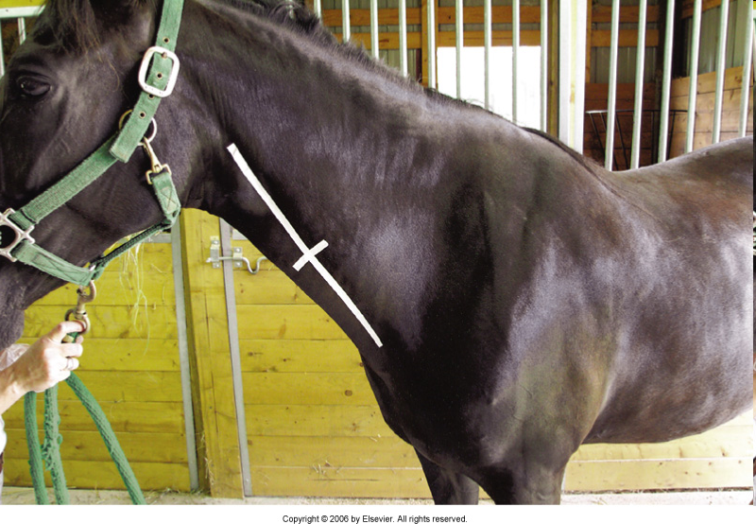
Always insert your needle into the cranial half of the jugular groove. If you hit the carotid artery the medication will flow with great speed to the brain and cause the horse to faint and/or die.

Slide 14
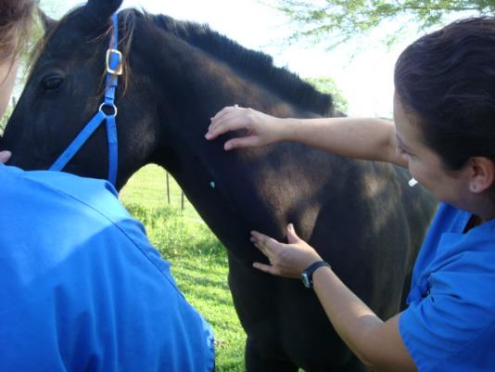
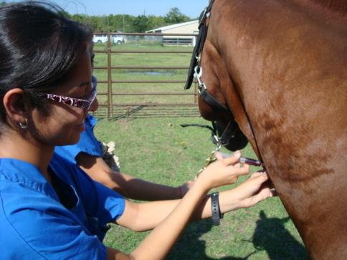
A needle is placed first into the jugular vein to administer intravenous medication to a horse to avoid accidental carotid artery injection

Slide 15
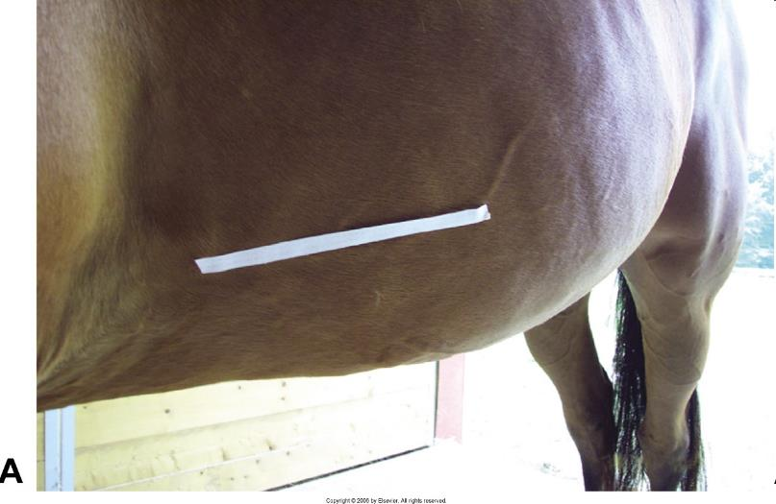
Location of the lateral thoracic vein. Needle sizes can vary from 14 to 22 ga in diameter and be 1 or 1 ½ inch in length.

Slide 16
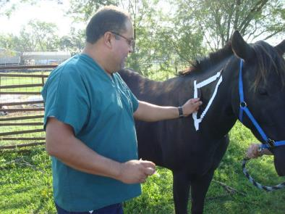
Subcutaneous Injections
Are the easiest to perform.
Most common place: lateral aspect of the neck.
  Subcutaneous
    20- to 22-gauge × 1 inch in length

Slide 17
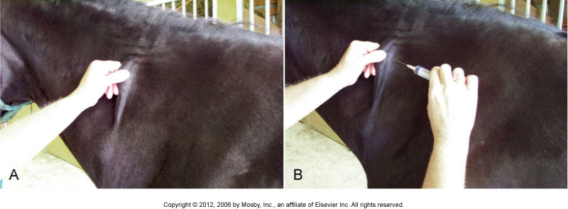

Slide 18
Intradermal Injection
Very rarely used to administer medications.
Only volumes of less than 1ml can be injected into the skin at a single site.
A visible bleb should appear in the skin.
    Less than 1 ml can be given
    25 × 1-gauge needle

Slide 19
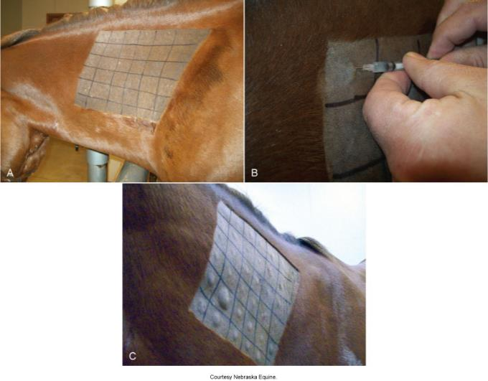

Slide 20
