Slide 1
Intravenous Catheterization

Slide 2
Catheterization
Catheters
  Most commonly used are 10-, 14-, and 16-gauge needles.
  10-gauge are recommended for emergency use.
  Almost always inserted into the jugular vein; if not available, the lateral thoracic vein can be used.

Slide 3
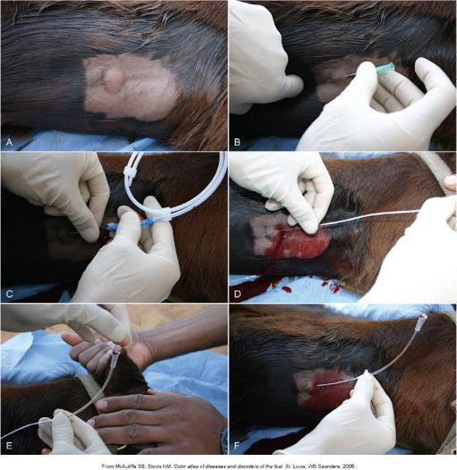
Catheterization (cont’d)
Notes:
3

Slide 4
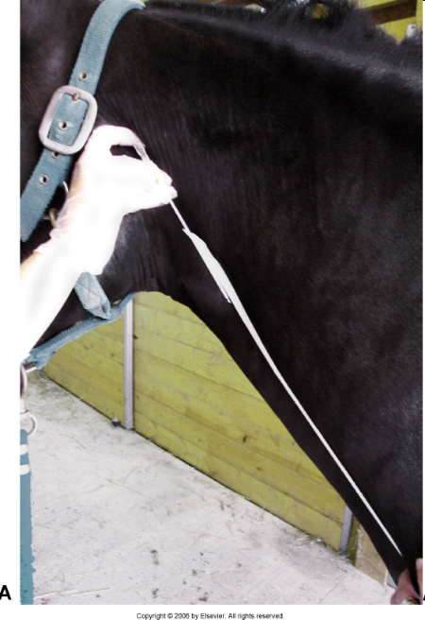
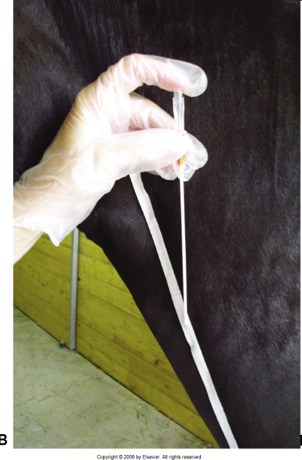
CORRECT
POSITION
INCORRECT
POSITION

Slide 5
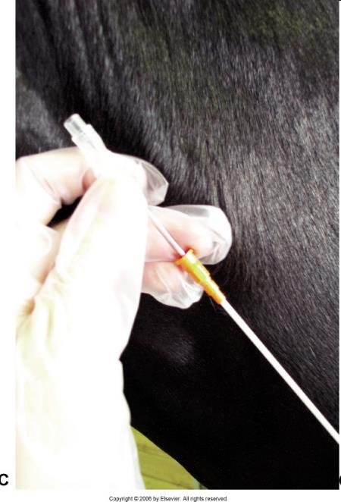
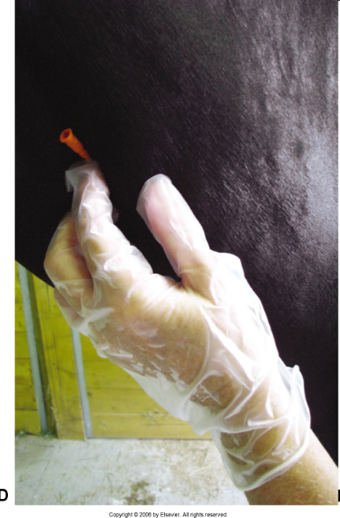

Slide 6
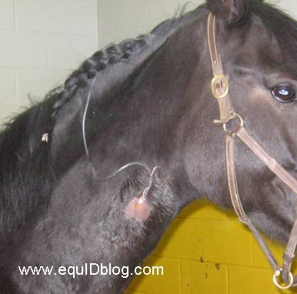
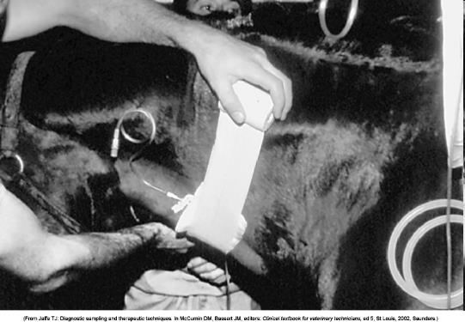

Slide 7
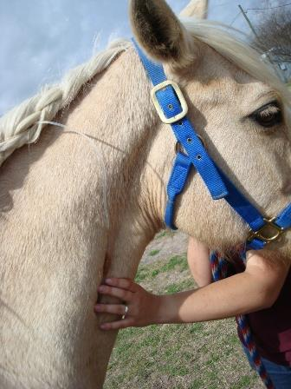
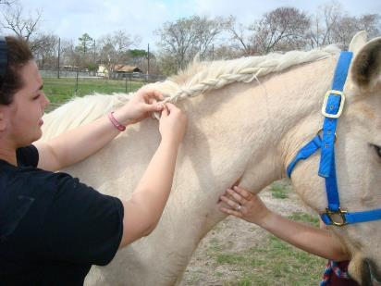
Crest Braided

Slide 8
Enemas
Newborn foals. Commonly given to newborn foals to encourage passage of the meconium (fetal feces). No special equipment involved, can use human pediatric enema solutions.
Fluids should be warm and nonirritating
Tube or hose
  No further than 12 inches
  1 to 3 gallons of liquid can be given to an average (1000 lb) adult horse

Slide 9
Flushing of the Nasolacrimal Ducts
A 20- to 22-gauge lacrimal cannula or a small-diameter flexible catheter (tomcat urinary catheter)
  Inserted into a punctum and sterile fluid injected via an attached syringe
Small 1- to 2-mm catheter inserted into the nasal punctum and sterile fluid flushed
Startled when the fluid suddenly enters the eye

Slide 10
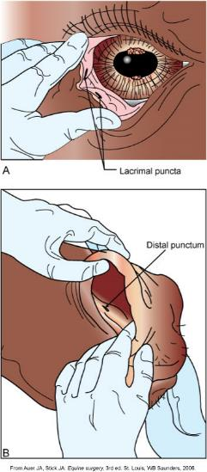
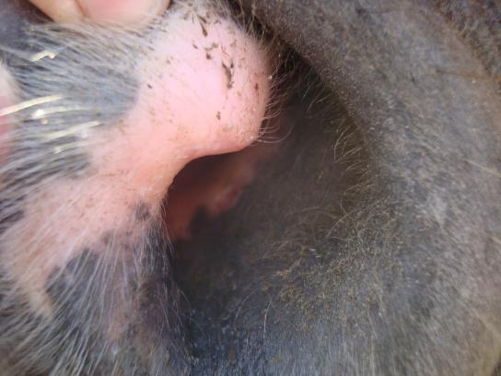
Nasolacrimal Ducts

Slide 11
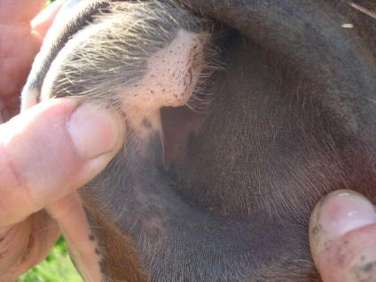
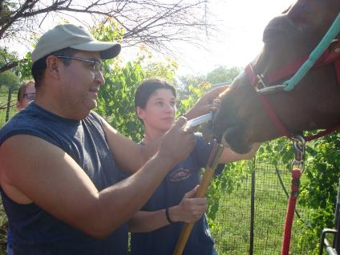
Restraining

Slide 12
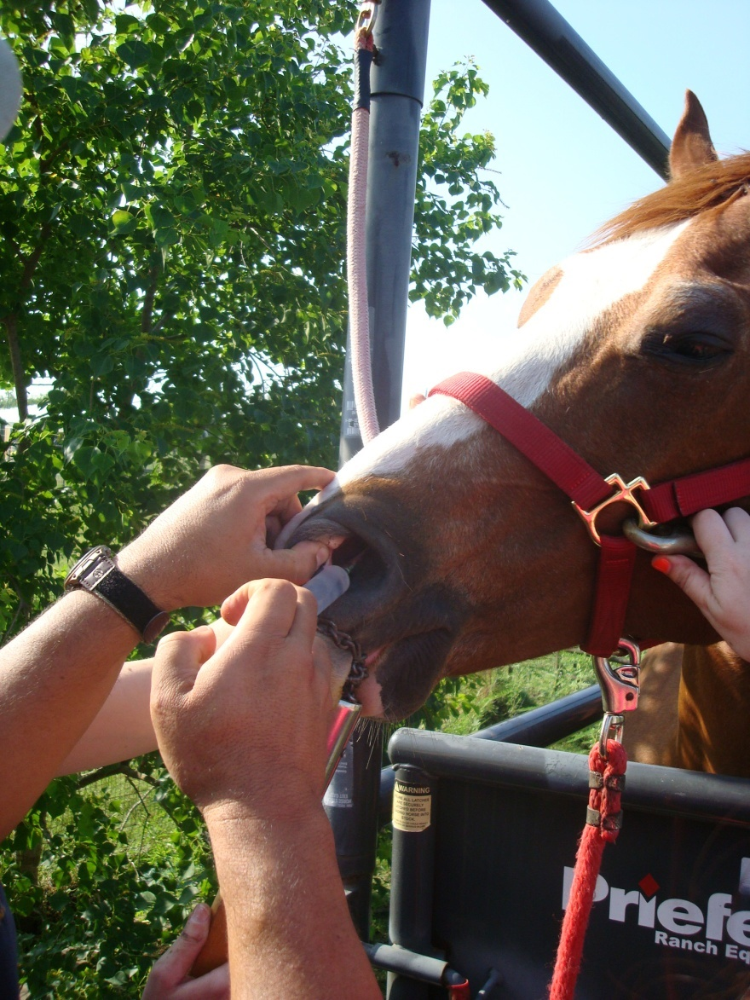
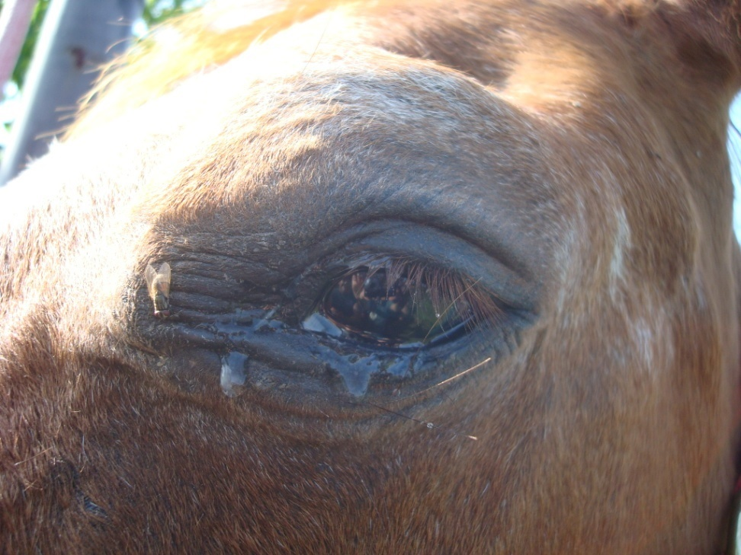

Slide 13
