Slide 1
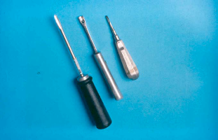
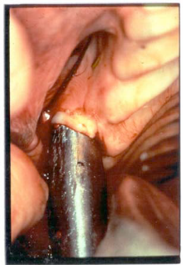
WOLF TEETH EXTRACTION:
Procedure:
Sedation
Local anesthesia
Loosen with periosteal elevator
Extract with small forceps
May require rongeurs to remove broken root from below gum

Slide 2
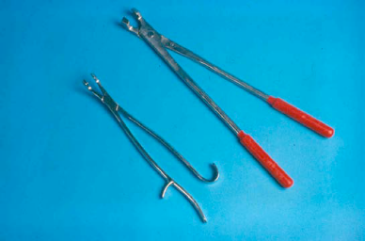
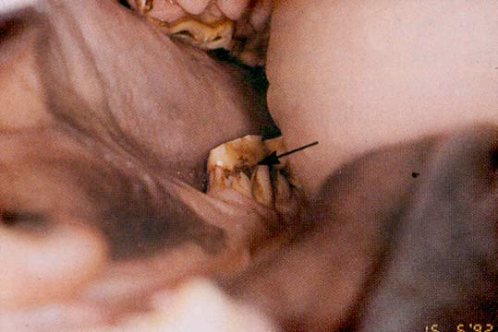
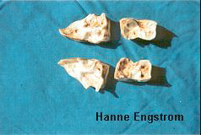
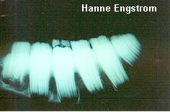
Retained Deciduous Premolars- Caps

Slide 3
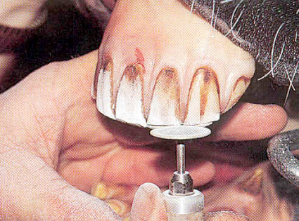
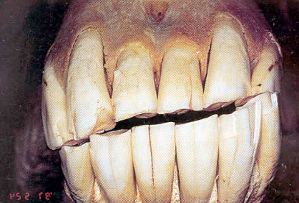
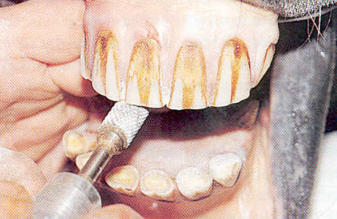
Incisor reduction
Correction of incisor misalignment
Hand float
Dremel tool
Motorized rasp
Procedure Improves molar contact

Slide 4
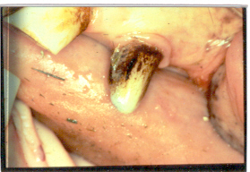
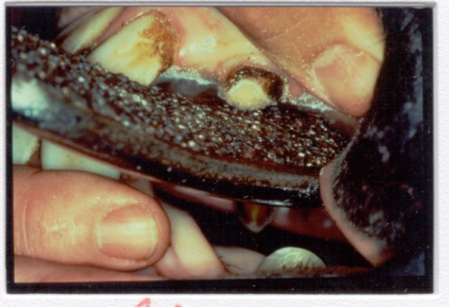
Canine Reduction
Erupts between 4 – 6 years of age
Reason for reducing canines
Disarm a horse with dental weapons
Prevents entrapping tongue between bit and tooth
Prevents ulceration of tongue
Prevents damage to canine by horse, bit, etc..
Prevents trauma to dentist
Pulp in young horses with 5-mm of crown
Reduce to level or just below occlusal surface of 06

Slide 5
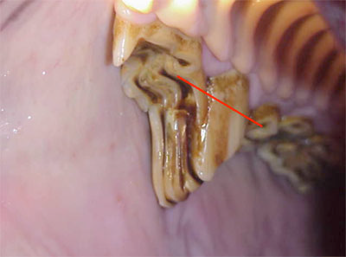
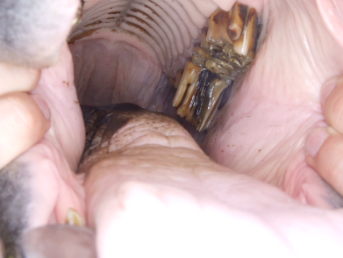
Molar/Premolar Reduction
Reduction of excess clinical crown
Severe ramps and hooks
Wave mouth

Slide 6
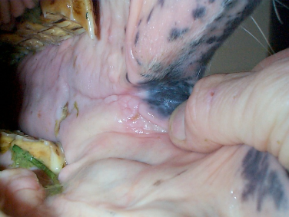
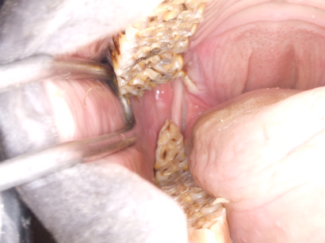
Hooks/Ramps
Excessive crown is greater in the vertical axis
Result of mal-alignment of the mandibular and maxillary arcades
Function of domestication

Slide 7

Step Mouth
Individual super-erupted tooth
Usually un-apposed
Missing apposing tooth

Slide 8
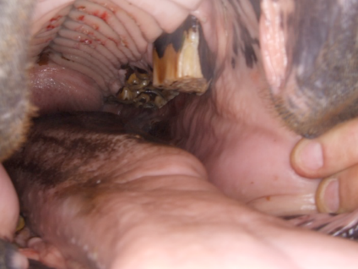
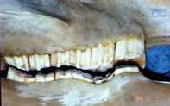
Wave Complex
A series of super erupted teeth apposed by a series of excessively worn teeth
Age related
Wearing of the infundibular enamel

Slide 9
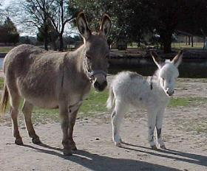
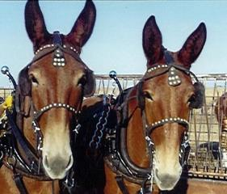
Do donkeys and mules require different dental care than do horses?
All equine species have the same type dentition.
We see the same types of pathology and wear patterns in donkeys, mules, zebras and horses.
Under current domestication practices, all require regular dental care.

